Slide 1

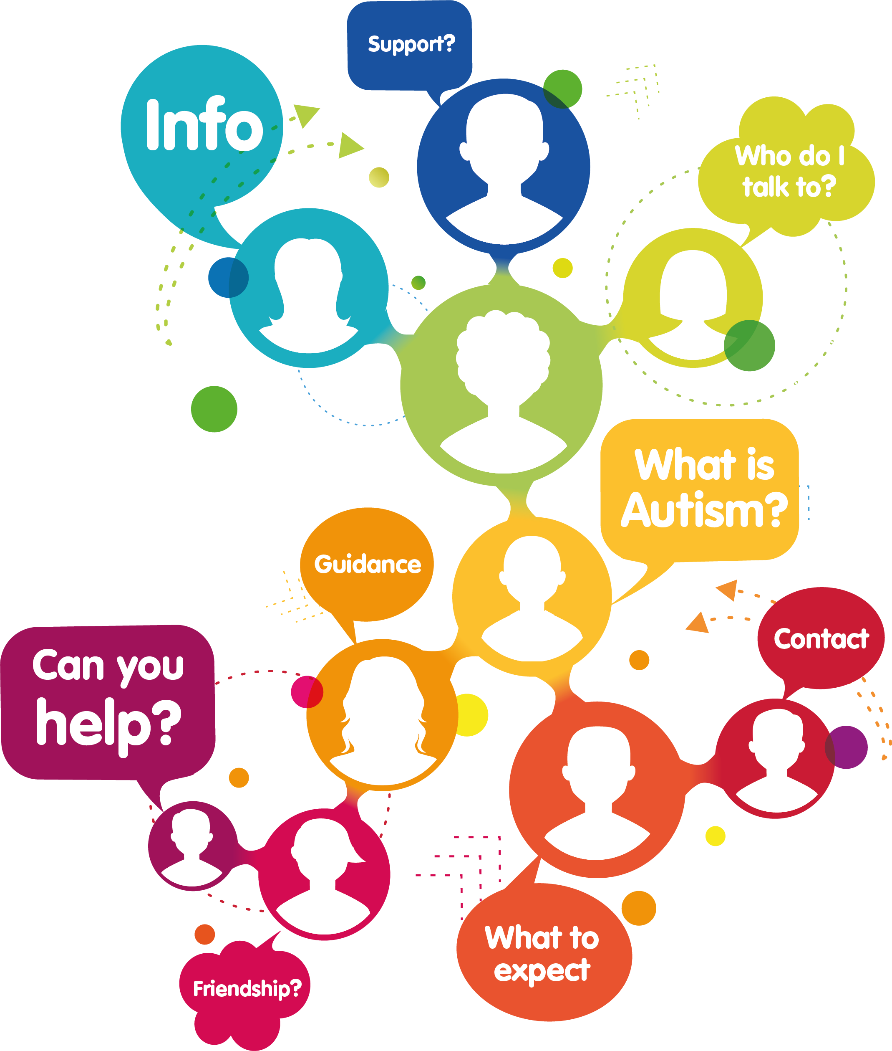
Reading Patient Voices
January 2025

Slide 2
Jane Stanford-Beale MBE FRSA
CEO at Autism Berkshire
National Autistic Society licensed trainer
National Autism Trainer Programme Adult Community Mental Health setting trainer
2024 Member of the Quality Improvement Programme (QIP) at Prospect Park to improve the inpatient experience for autistic adults
  launch of Sensory Trolleys,
  Training Turbos for targeted patient’s sensory needs,
  predictable timetabling and Autism Champions on the wards
  Outcome fewer restrictive practices against autistic patients

Slide 3
What is autism?
Autism is also known as:
  Autism spectrum condition (ASC) or Autism spectrum disorder (ASD) (many autistic people say they are not disordered so do not want the term used) or Asperger’s syndrome.
  Now Neurodiversity! We take a strength-based approach, not disability.
It is a neurodevelopmental condition that people are born with.
Some people may not notice differences until later in childhood or adulthood.
Clinicians are aware autism can present in different ways for different people and groups (e.g. in women)
Autism Berkshire Adult Support Service Introducing the Berkshire Adult Autism Support Service - Autism Berkshire

Slide 4
Challenges
Autistic people often share similar challenges across their life, including in education, employment, and social relationships.
  finding social situations tiring and difficult
  struggling to understand what other people feel, intend or mean
  finding it difficult to deal with changes in their plans or environments
  preferring to follow rules and routines, having a need for predictability
  becoming absorbed in interests to an extent that can interfere with relationships or activities
  being over (hyper) or under (hypo) sensitive to certain sensory stimuli (e.g. sounds, lighting, smells, textures or bodily sensations)
  Autistic people are more likely to be diagnosed with anxiety or depression.

Slide 5
Strengths
Love of routines, can be very dependable employees
Good attention to detail
Very loyal and stay in post for longer than the average worker
Most whistleblowers are autistic
Black and white understanding of rules eg traffic officers
Many lawyers, police officers, surgeons, accountants and auditors are also autistic, and very good at their jobs!

Slide 6
THRIVE MODEL – ANNA FREUD
Needs lead, graduated support, whilst on waiting list and, post diagnosis support. Strength based, social model.
Getting Advice and Signposting
Getting Help
Workshops
Getting More Help
Getting Risk Support
Close working with CMHT, Keyworking Service and social care on complex cases to provide emotional support to individual, and their Carers
Single session therapy
Email support/secure referral form on website
Signposting to local/national organisations Sport in Mind,
Recovery Colleges and GRAFT
Sensory Differences
Art Workshops
Chop & Chat courses for adults
Social clubs - young people and adults
Follow up to workshop session
Planning and Organising
Autism and Anxiety
Understanding Other People
Drop in Sessions Daytine Atrium Reading, Evening the Bear Maidenhead
Signposting for emotional wellbeing of the Carers
THRIVING

Slide 7
Case studies 1
T comes to the Atrium Drop Ins with her support dog. For her first visit, she just came in and observed the group. At the next session she was able to speak to Michelle. Now she attends regularly and welcomes new members to the group.
T has attended the workshops, which she found hard going. She said they were a lot to take in, and she needed time to reflect and accept the information. T was diagnosed in her 40s so has found it difficult to accept that she was not diagnosed earlier in her life and did not have support through her education and employment.
Sadly her partner passed away at the end of May, and Michelle gave her support around securing her tenancy and signposted her to Communicare for benefits support.
T is feeling much stronger and has had some training to become a Peer Mentor at the Atrium Drop In sessions in Reading.

Slide 8
Case studies 2
N 22 self referred herself to us after Michelle and Jane were invited to speak to a church group in Caversham. N had been diagnosed with autism at 12, when she went to secondary school, and had an EHCP but was not doing anything following leaving Reading College the previous summer. She had applied for jobs but was not successful. N was interested in working in catering. Jane followed up with Maggie Buckley SEND Manager in Reading and confirmed that the EHCP was still valid that N could apply for a “Supported Internship”.
Sadly N’s mother became seriously ill and then died unexpectedly in following a short stay at the Duchess of Kent House. She took comfort in knowing that N was being supported by Autism Berkshire and was being put forward for a Supported Internship.
N and her father have been regular visitors to the Drop In sessions at the Atrium. Jane was able to give support around arranging the funeral. He was also anxious about dealing with financial matters and Jane was able to guide him as she had previously worked in a High Street bank and has financial advice qualifications. The father was also referred to the Martyn Lewis website Money Saving Expert to the “Difficult Conversations section”.
N has started to attend the summer art classes in Maidenhead and is enjoying them. She has started her internship and with the Shaw Trust is feeling very positive about the future. Feedback from her first two placements is that both employers would offer her a full-time job.

Slide 9
Support for Children and Young People
Support in schools in “Needs Led”
Schools put support in place according to the needs of the individual child eg extra phonic work, LSA support in the classroom
Parents can access support and self refer to Autism Berkshire as soon as they are concerned about their child Introducing the Berkshire West Autism & ADHD Support Service - Autism Berkshire (no diagnosis required)
A child does not need a diagnosis to access support.
Major investment by RBC (Brighter Futures for Children) in training for school staff in Autism and SEND generally

