Slide 1

Reading Patient Voice
18 September 2024

Slide 2
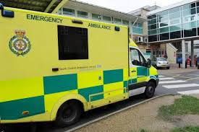
South Central Ambulance Service
What SCAS does
What is a Governor
And how and why I became one

Slide 3
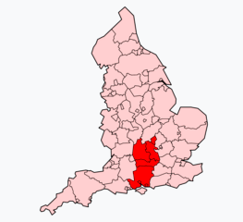
SCAS – What does it do?
999 Emergency calls
NHS 111 service
Patient Transport Service
And work with
Community First Responders
Voluntary Car Drivers
Specialist Operations
Courier Services
Air Ambulances

Slide 4
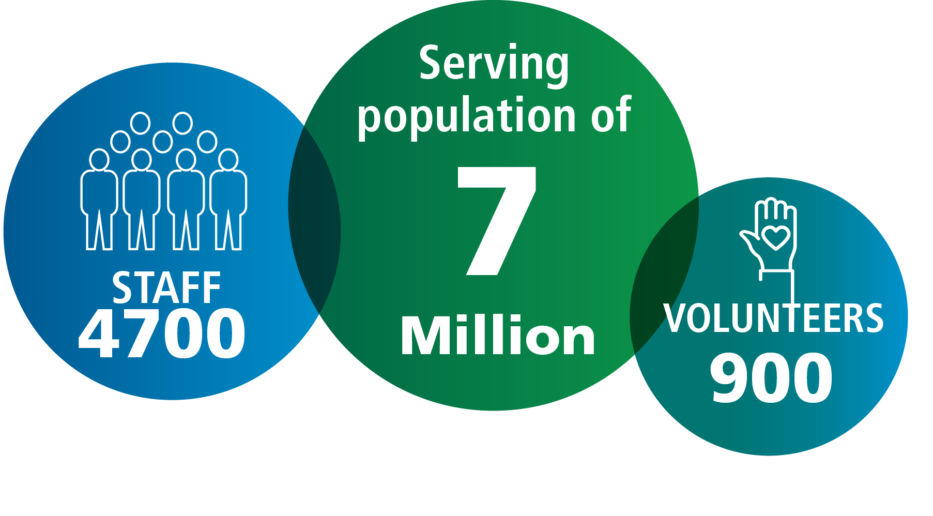
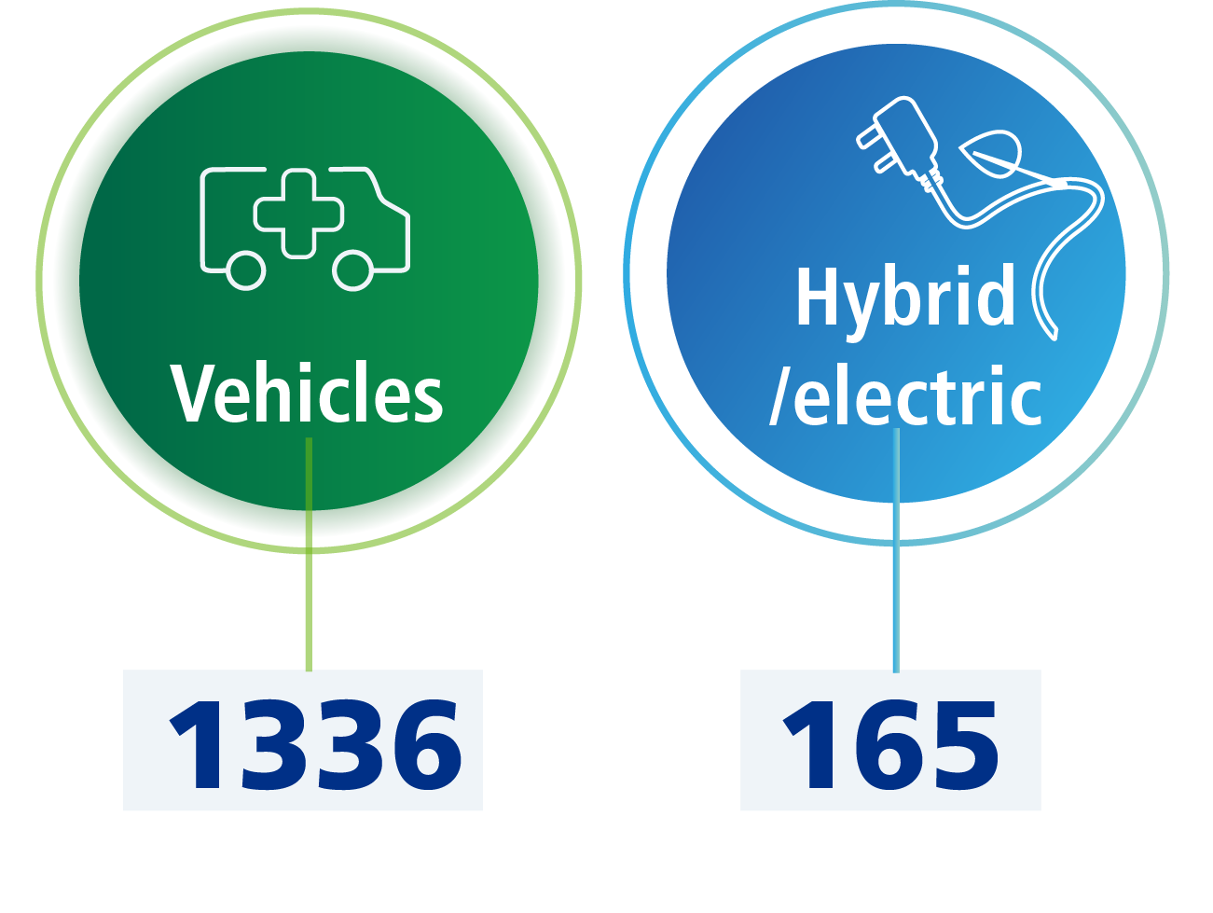
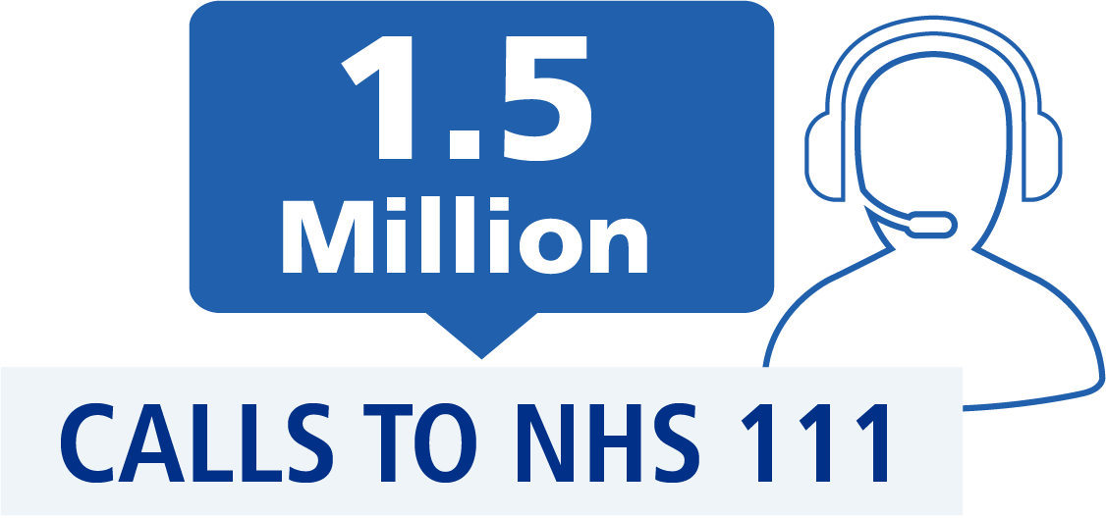
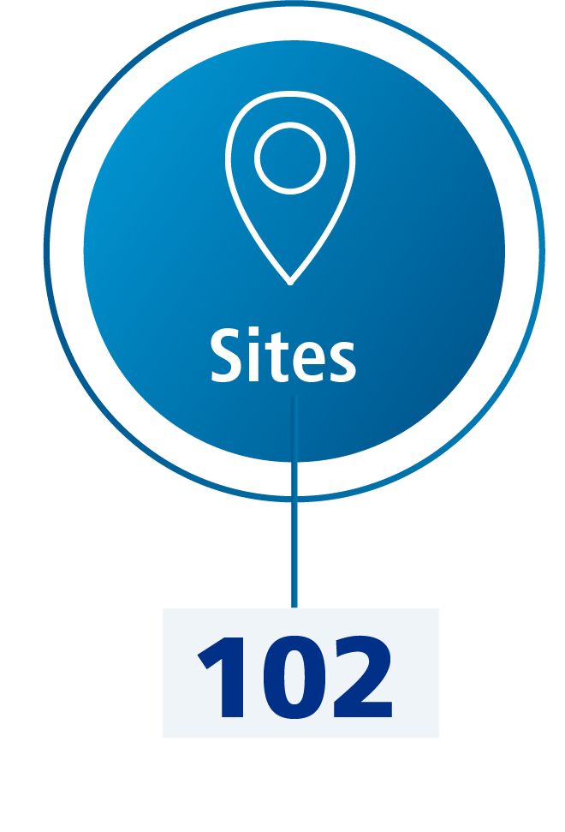
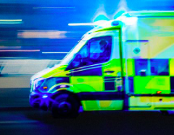

SCAS – What does it do?
606,287 999 INCIDENTS

Slide 5
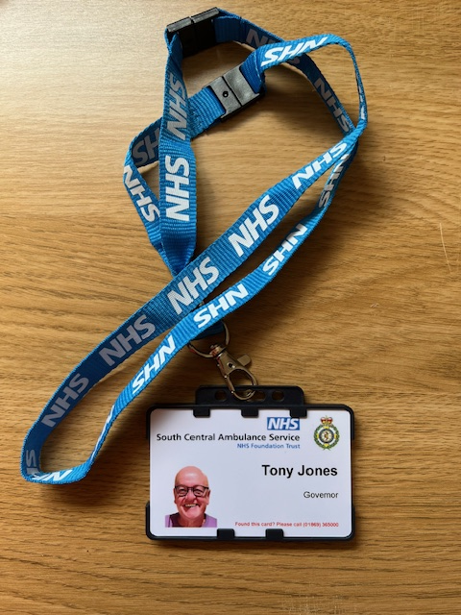
How and why I became a Governor
There was a vacancy in Berkshire
Help improve the service
Find my replacement

Slide 6
The role of the Governors in SCAS
REPRESENTATION
To provide public, staff and stakeholder representation
on the strategic direction of the Trust.
ADVICE
To advise the Board of Directors - so that the Trust acts
in a way which is consistent with its objectives and values.
ACCOUNTABILITY
To make the Trust publicly accountable.

Slide 7
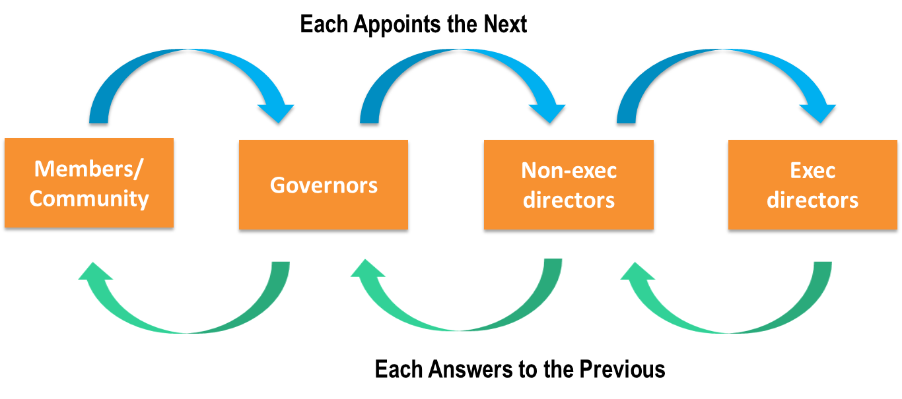
SCAS Governance - How does it work?

Slide 8
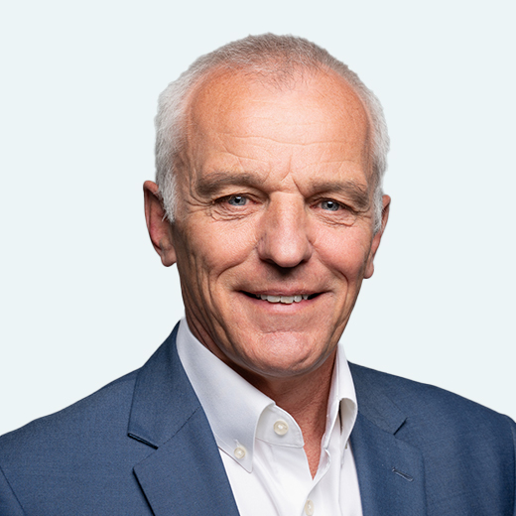
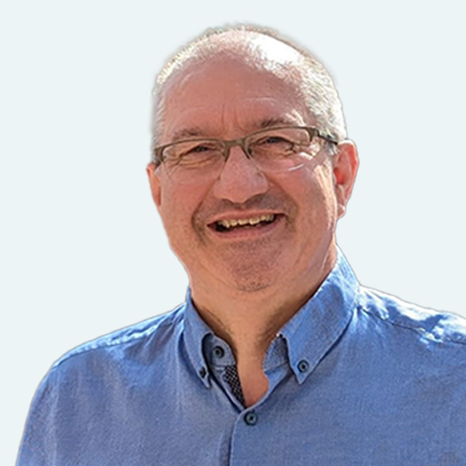
SCAS Leadership
Professor Sir Keith Willett CBE
Chair of the Trust
Leads the Board of
Non Executive Directors
David Eltringham
Chief Executive
Leads the paid staff including Executive Directors

Slide 9
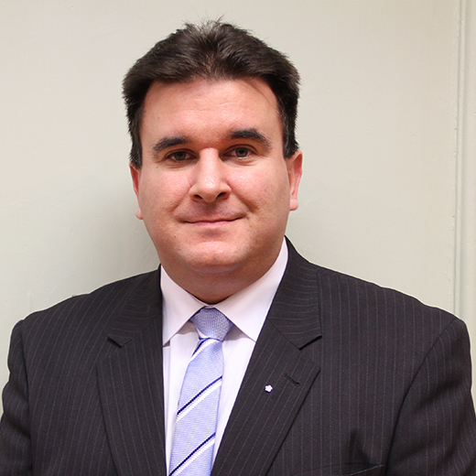
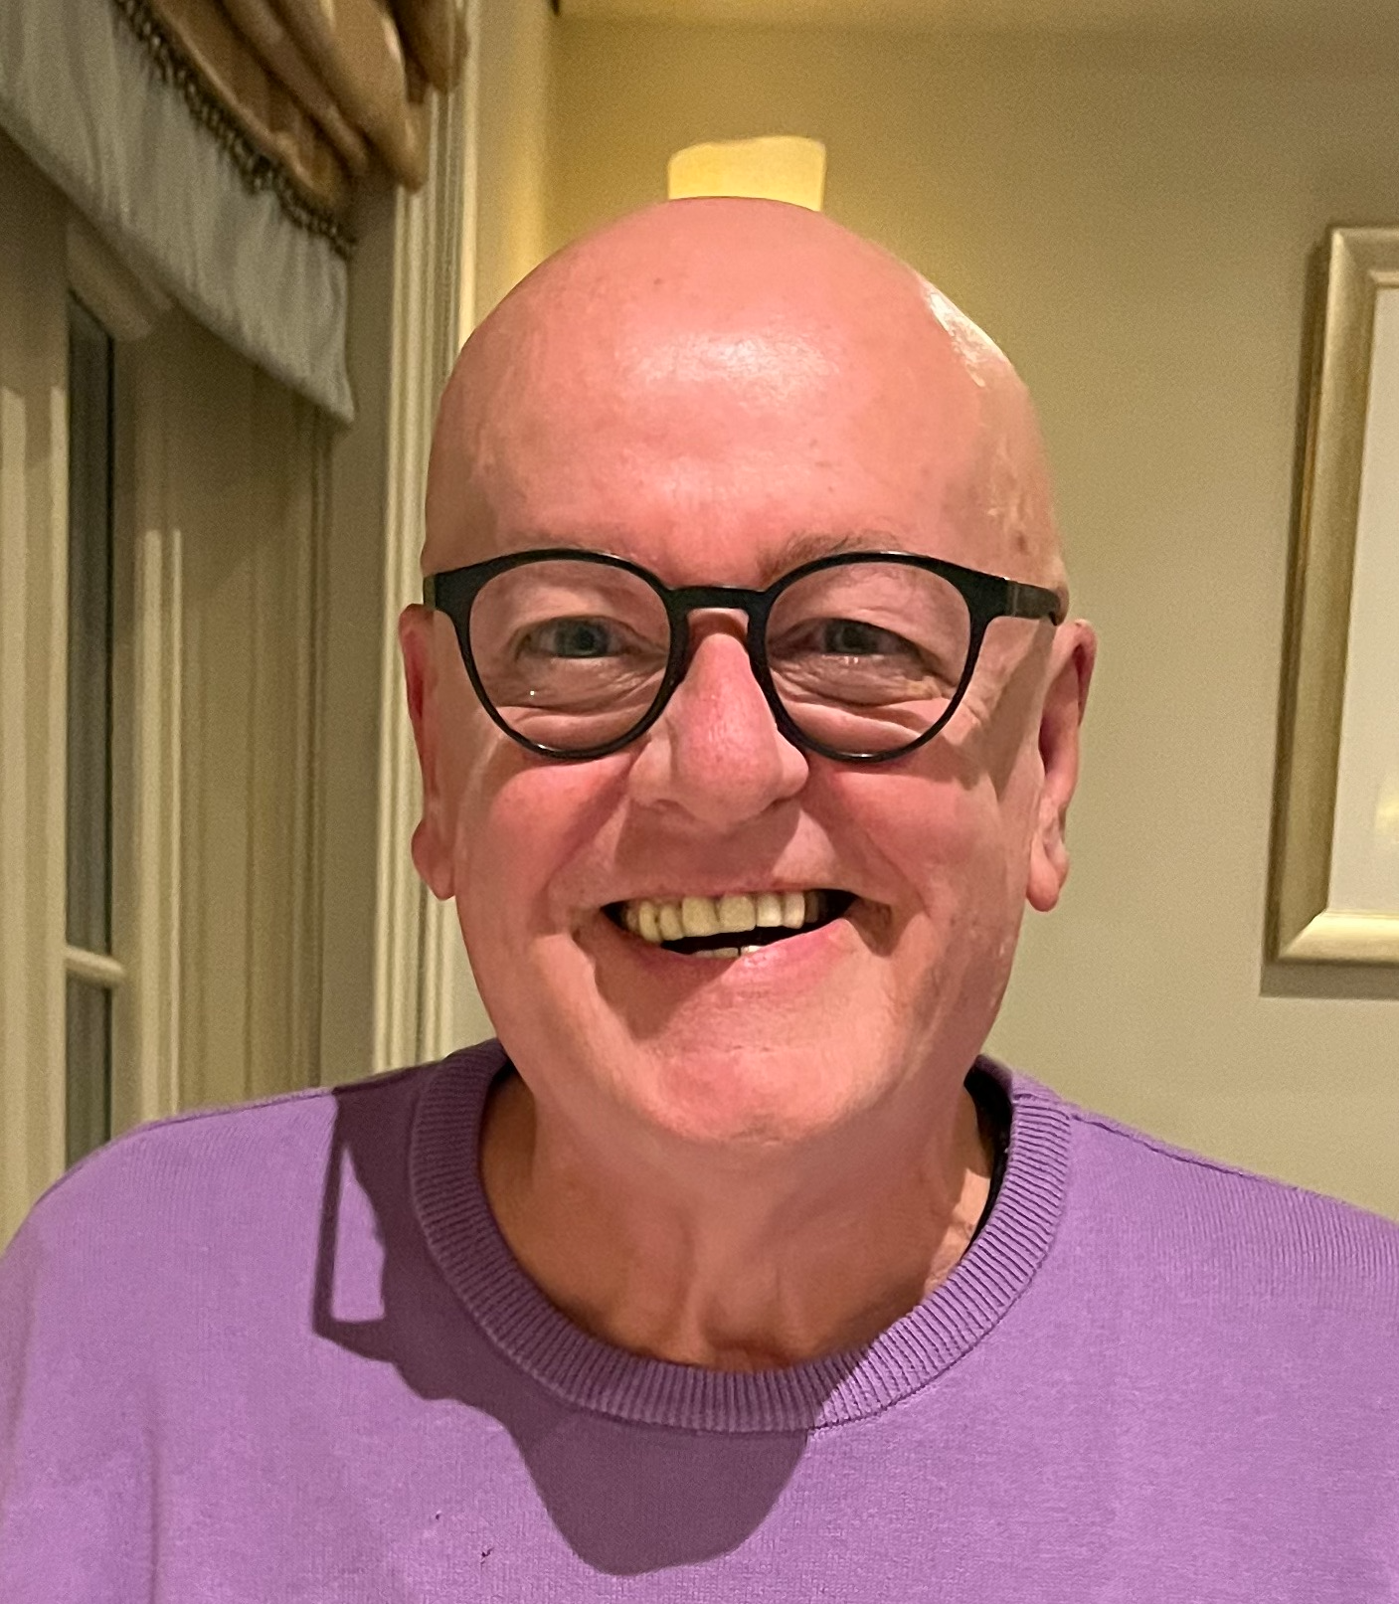
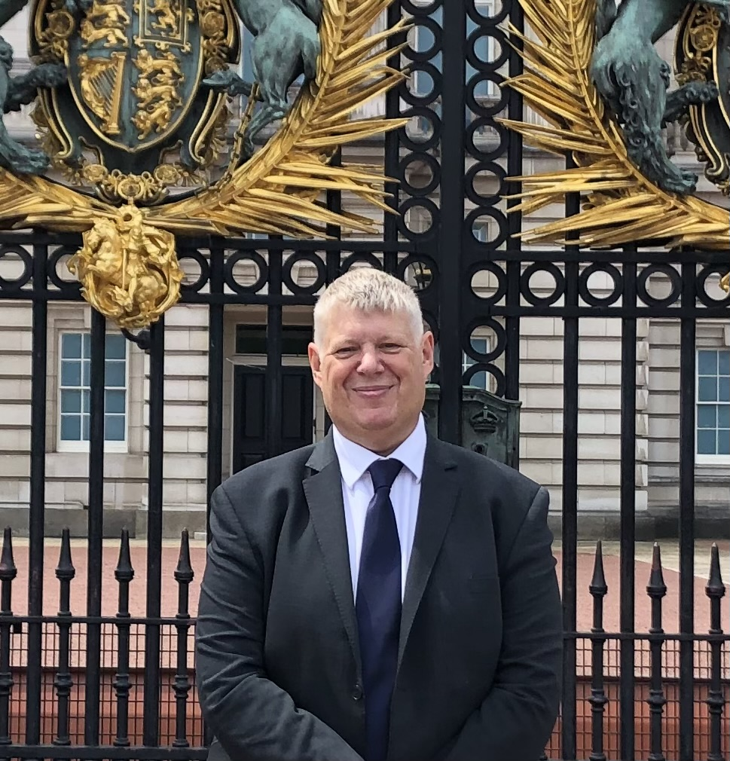
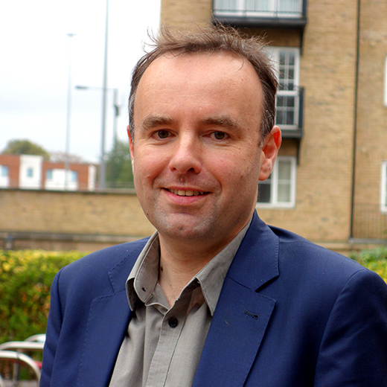
Council of Governors
There are 27 Governors in SCAS – 15 elected, 6 appointed & 6 staff
BERKSHIRE
Mark Davis
Elected
Tony Jones
Elected
Mark Potts
Elected
Graeme Hoskin
Appointed

Slide 10
Our mission
We deliver the
Right care
First time
Every time
Our mission focuses on our determination to be clinically led with patient care being at the heart of what we do and why we do it.
Our Vision
To be an outstanding team, innovating and partnering, to deliver world leading outcomes.

Slide 11
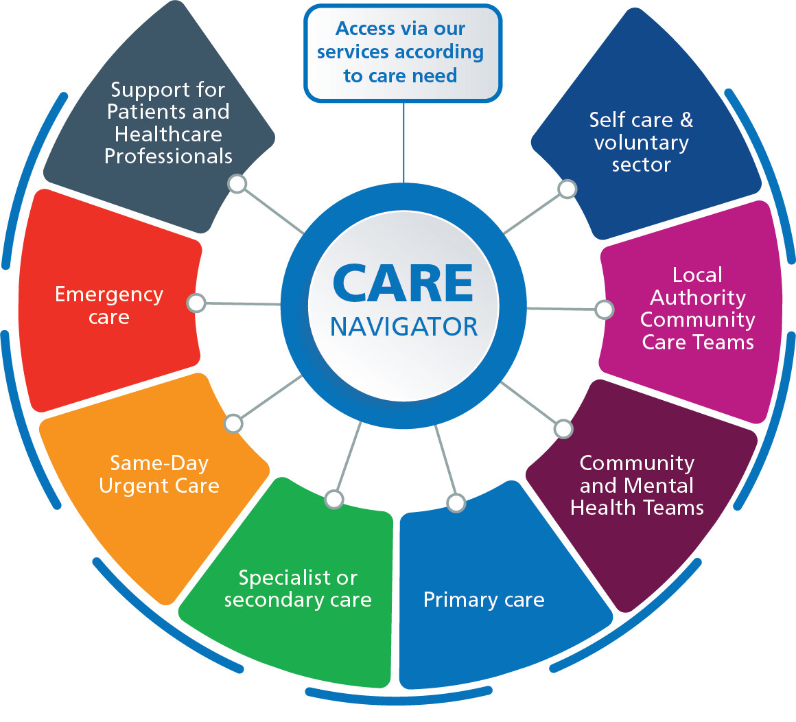
Our strategy
A core objective is to work as an effective care navigator within the wider NHS
Providing patients with immediate care
Getting them to the right services for their on-going needs
Notes:
Ambulance trusts are critical partners in the wider NHS systems we work in.
Lots of work happening to expand clinical pathways that our teams can direct patients to – about giving patients the best care possible and limiting the pressure on A&E departments.
Give an example of how the options for road crews have changed in recent years with direct access to specialist hospital departments or community services that will come and follow up care in a patients’ home

Slide 12

Reducing Health Inequalities
”Reducing inequalities in access to the building blocks of health”
Ass Ambulance Chief Execs
1. Use data to understand population need
2. Reduce barriers for specific groups
3. Improve care for vulnerable groups
4. Inclusive recruitment processes
5. Review Trust estate
6. Reduce environmental impact
7. Support staff well-being
8. Purchasing locally

Slide 13
Current challenges in SCAS
IMPROVING THE TRUST
SCAS is currently rated as Inadequate by the Care Quality Commission (August 2022)
ADDRESS HEALTH INEQUALITIES
Can we use the Care Navigator and/or the AACE models to help address the significant health inequalities across the Trust area?
GROW TRUST MEMBERSHIP
There are 4,411 public members – covering a
population of 7 million

Slide 14



Slide 15

THANK YOU
www.scas.nhs.uk
Any questions?

