Slide 1
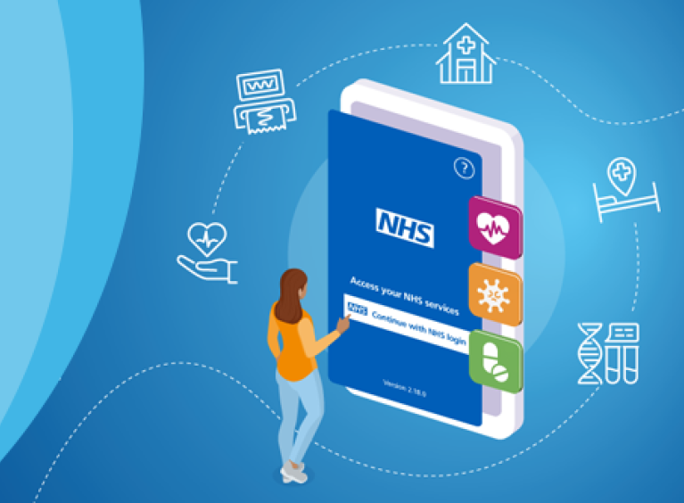
NHS Digital Access
Marta Fischer
Digital Access Lead BOB ICB
Marta.Fischer2@nhs.net

Slide 2
Digital access routes
NHS Account
NHS App
General Practice
Websites
Access with NHS Login
No account required
Health records, medication ordering, GP and hospital appointments, 111 services, proxy access
Self-triaging, appointments, medications, general information about GP services

Slide 3
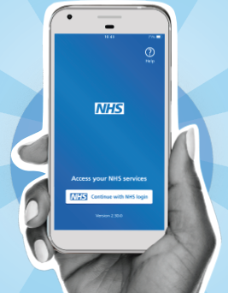
Benefits of digital access
Improves communication
with patients
Reduces costs
Repeat prescriptions have saved approximately 2.9 million hours of GP practice time, saving around £27.7 million.*
* Sourced from the NHS APP Team
Efficiency
Each month the NHS App saves 336,000 hours of administration
time across
our 6500+ practices
Reduces Carbon footprint
Empowers patients
Convenience
Integration with other services

Slide 4
What can you do with the NHS App?
Register with a GP without
proof of address or
immigration status.
Book and manage GP, vaccination and hospital appointments.
View your GP records securely.
Find trusted NHS information and advice.
Order repeat prescriptions.
Register your organ donation.
Receive messages about your care.

Slide 5
Thank you

