Slide 1

Primary Care
Current State Report
December 2023

Slide 2
Contents
 | Introduction | 3 - 7
 | Current state analysis | 8 – 80
 | Model of care
 | Estates
 | Workforce
 | Processes
 | Technology
 | Information
 | Governance
 | Summary and Conclusions | 81 – 87
01
02
03

Slide 3
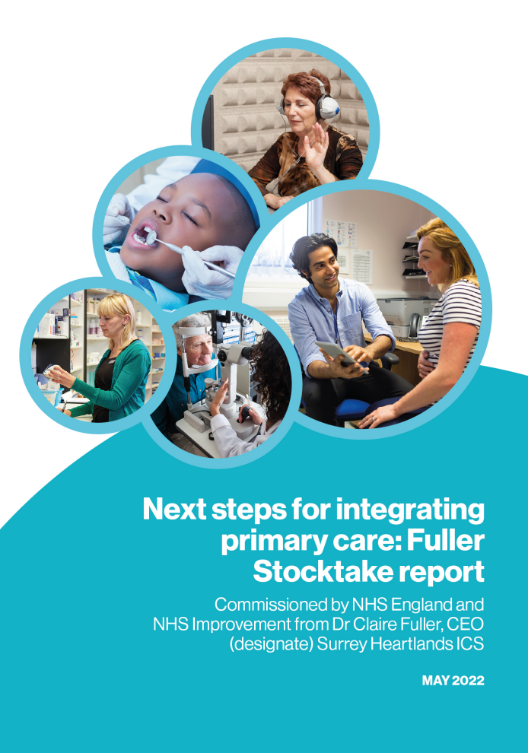

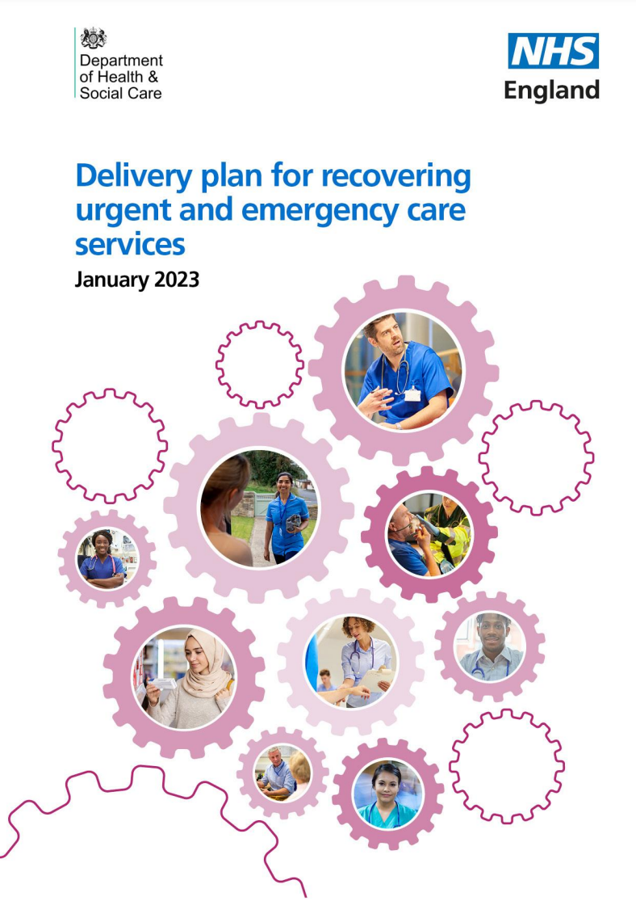
National and Local Context
  At the heart of the Fuller Stocktake is a new vision for integrating primary care, which centres around three components:
    Access – streamlining access to care and advice for people who get ill but only use health services infrequently
    Continuity – providing personalised care from a multidisciplinary team to people with more complex needs
    Prevention – helping people to stay well for longer
  Nationally, access has been prioritised in 2023, with guidance, funding and improvement support available for primary care.
  National and local plans to tackle delays in ambulance and emergency services include a strong focus on expanding access to care outside of hospital to avoid people ending up in the emergency pathway unnecessarily.
  BOB ICS is putting primary care at the heart of our transformation – to deliver our vision that:
  Everyone who lives in BOB should have the best possible start in life, live happier, healthier lives for longer and be able to access the right support when they need it.
  We currently deliver some outstanding primary care, but services are under considerable pressure, we have workforce gaps, high workloads and inequalities in access, experience and outcomes across our population.
  As a result, we are developing a system-wide primary care strategy that has the following objectives:
Improve patient experience​
Improve outcomes for long term conditions​
Ensure access to same day care where clinical need​
The Fuller Stocktake
Recovering access to Primary Care
Recovering Urgent and Emergency services
Reduce workload pressure in primary care​
Improve staff experience​
Create a more sustainable model of Primary Care

Slide 4
Approach to developing the primary care strategy
Research on good practice
Researched global, national and local examples of good practice delivery of Primary Care services within other systems and within BOB.
National guidance such as The Fuller Stocktake
BOB Five Year Joint Forward Plan
System-wide workshop
Bringing together over 130 stakeholders from across the system to discuss the future vision and opportunities for the model of Primary Care.
Building our understanding on the current state of Primary Care
Carried out focus groups with key stakeholders (including core clinical groups and patients), and successfully seeking views from the four pillars of Primary Care through a shared survey approach.
Data Analysis
Analysed key pieces of data such as GP appointments, volumes of 111 calls and ED attendances.
Ongoing engagement
Feeding in all research and engagement so far to start drafting the strategy while continuing to meet with key stakeholder groups to get their input and feedback.
First draft of the Primary Care Strategy
Will outline the key challenges facing Primary Care and how we plan to address these as a system through a change in our model of care. Engagement with system partners’ and our population will continue to get their input and feedback for the final version.

Slide 5




How this report was developed
We've heard from around 150 stakeholders across BOB
Primary Care engagement
Focus groups with GPs across all Places
Focus groups with Practice Managers across all Places
Focus groups with Pharmacy, Optometry and Dentistry
Meetings with Primary Care Federations, Primary Care Alliances & Local Medical Committees
System partner engagement
Local Authorities
Adult Social Care Leads
Public Health Leads
Healthwatch
Community providers
Acute providers
Mental health providers
ICB Leads
Place Directors
Clinical Networks
NHS South East Regional Leads
VCSE
Academic Health Science Network
Survey shared with GP, Community Pharmacy, Optometry and Dentistry
Analysis of GP Patient Survey 2023, BOB GP Patient Survey Dental Statistics 2023 and GP appointments, ED, UTC/ UCC, 111 data
Review of documents including BOB LMC data, JFP Service Delivery Plans; PCN estates toolkits; PCN Capacity and Access Improvement Plans, Healthwatch Reports on Primary Care, BOB Integrated Care Strategy and Joint Forward Plan Public Engagement Reports

Slide 6
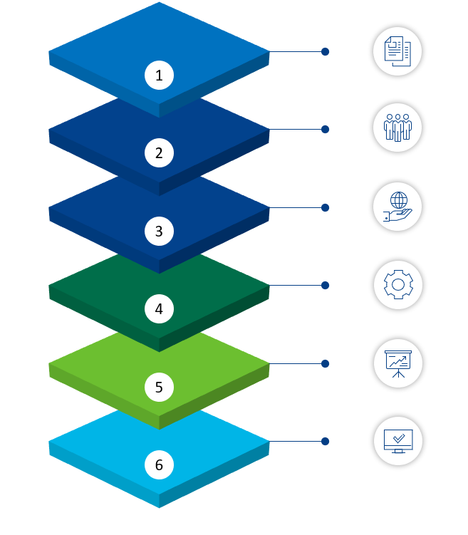












Framework used in this report
This report covers the four pillars of Primary Care – General Practice, Pharmacy, Dentistry and Optometry – and their interface with the wider system, in particular community services. It looks not just at the model of care (services and how and where they are delivered) but at the enablers that underpin it, like workforce, technology and data. The model of care is subdivided into three key objectives for primary care – access to primary care for patients with an acute primary care need, continuity of care for patients with longer term medical and social issues, and prevention of ill health for our population (regardless of baseline health status).
Model of Care with Enablers:
Model of Care:
Access
Model of Care
Self Care
Triage & Navigation
Initial Contact
Workforce
Processes
Continuity
Technology
Identification
Assessment
Management
Evaluation
Information
Prevention
Governance
Population Health Needs Analysis
Opportunity Analysis
Intervention Selection
Implementation and Evaluation
Commissioning and Incentive Alignment

Slide 7










BOB’s population and context
Our population
Health needs and inequalities
c.60,000 people in BOB live in an area that is in the bottom 20% of areas nationally as defined by deprivation.
Our overall population size is anticipated to grow by 5% by 2042, over the same period the number of people aged over 65 is expected to increase by 37%.
Across BOB, 3 in 5 adults are overweight or obese. 68% of adults with a learning disability are overweight.
Around 12% of adults have a recorded diagnosis of depression and 0.8% have a severe mental illness.
Within BOB, Oxfordshire and Buckinghamshire will continue to have the highest proportion of over 75 year olds.
Estimated 60% of people over 60 have one or more long term conditions.
People in our more deprived areas develop poor health 10-15 years earlier than those in less.
People who identify as white British make up 73% of residents. Although this differs from 53% in Reading to 85% in West Berkshire.
BOB has 8.8 care home beds per 100 people 75+ in comparison to the national average of 10.8 as well as a slightly smaller 16+ population with a caring responsibility.
Deprived patients in Berkshire West and Oxfordshire are overrepresented in emergency admissions
Source: BOB fact pack and BOB Joint Forward Plan 2023

Slide 8
1. Model of Care

Slide 9



Good practice on Access
Model of Care
Estates
Workforce
Processes
Technology
Information
Governance
Where systems – both globally, nationally, and within BOB – have made progress on delivering better access for patients with an acute primary care need, they tend to have some or all of these features, grouped into three core components:
Self Care and Demand Avoidance
Triage & Navigation
First Contact
Self triage - the patient is able to first attempt to assess and manage their symptoms without being seen by a clinician.
Self management - the patient has access to reliable, evidence-backed and trustworthy information about how to self manage common minor ailments. The patient is empowered to make decisions through knowledge.
Digitally enabled triage and management functions, for example the patient can access repeat prescriptions without having to make a call.
Access to good quality services for long term care – interventions to improve same day access worked best in conjunction with parallel work to improve management of complex, long-term conditions.
Scale – can operate at both large and small scale e.g. at national level (111), PCN level or practice level
Breadth – undifferentiated symptoms require an open access approach with a wide triage funnel
Standardised and codified triage process– for unity and scale
Defined clinical pathways – behind triage function
Senior decision making upfront – to avoid pinball effect of seeing the wrong practitioner first time
AI-enabled clinical decision support – supports a multidisciplinary team approach
Prior risk stratification – enables early recognition of patients requiring continuity of care
Co-siting of triage teams – to support supervision and collaborative team working – often in one location / hub
Single point of access – Patients value having a clear destination for single point of access.
Multidisciplinary teams – models with a broad MDT were able to achieve greater scale
Omnichannel access – patients valued choice with respect to access with options for remote / F2F and synchronous / asynchronous
Strong supervision – models with a broad MDT require good senior supervision
Clear scope of practice– models with a broad MDT require clear role definition
Internal upskilling – prioritised upskilling of existing staff
Interoperability – Models worked best where there was good interoperability of health records
Integrated – models that worked best were integrated with the wider system e.g., intermediary care, VCSE, palliative care etc.

Slide 10

Summary of findings for Access
Model of Care
Estates
Workforce
Processes
Technology
Information
Governance
Access to Primary Care services is a priority for people. For the majority of the population – who are generally well – would like to receive timely and easy access to primary care services. For people with Long Term Conditions, medical and social complexity, timely access to advice, guidance and treatment is also important. In BOB, a summary of the key findings for access are listed below:
There are a range of primary care access models in place across BOB, responding to different population needs and workforce assets.
BOB has slightly lower numbers of GP appointments per weighted population than the national average - but is nevertheless delivering a slightly greater proportion of appointments within 14 days than the national average.
Total GP activity has risen slightly over 5 years, driven by increased telephone consultations.
Patient satisfaction with access to GP services and NHS dentistry has declined over recent years and varies across Places; many patients saying it took too long to get care or advice when the GP is closed. This is in contrast with high levels of satisfaction once people have accessed services. People also stated there were no dental appointments available or said that dentists were not taking on any new patients.
Patient satisfaction with access has declined over recent years and varies across Places.
Buckinghamshire has the lowest number of GP appointments, the highest proportion of same day access, and the lowest patient satisfaction with access.
111 calls peaked in 2021 in all Places; in 2022 Oxfordshire had the lowest number of calls, but the highest proportion of out of hours calls.
ED activity has risen slightly since 2019 with higher acuity activity rising fastest; Urgent Care activity has dropped slightly.
Berkshire West has a higher rate of A&E activity then other Places.
Available data suggests BOB has a lower percentage of dental patients seen by an NHS dentist than the national average
Data was unavailable but local reports suggests there is scope to make even more use of capacity in community pharmacy and optometry.
10

Slide 11
There are a range of primary care access models in place across BOB
Model of Care
Estates
Workforce
Processes
Technology
Information
Governance
There is no single model of access across BOB or across any of its Places. The below summarises some of features that have been raised in engagement in relation to each Place – in most cases these features will not apply in all PCNs or practices, but they provide some context and food for thought when considering the data analysis that follows on subsequent pages. Demographic factors also differ across Places and neighbourhoods, with some communities facing inequality in experience, access and outcomes in relation to primary care. These inequalities can also contribute to some of the differences the subsequent analysis points to. Some relevant demographic comparisons between Places are included in the blue boxes.
Buckinghamshire
Higher levels of social isolation
Higher proportion of over 75 year olds
Higher proportion of 16-17 years not in education, employment, or training
Model of same-day booking based on patients calling on the day or being asked to call back.
111 calls directed to primary care are routed to the Clinical Assessment Service, which closes 80% on the phone.
Connected Care provides a shared care record for many providers across the health and care system.
Oxfordshire
Deprived areas cluster in Oxford and Banbury
Higher proportion of over 75 year olds
Children receiving free school meals have lower levels of good development
Patients who call 111 and are directed to primary care are told to call their home practice for an appointment.
Urgent Care Centres reportedly well-utilised and sometimes over-subscribed.
Progress has been made for GPs to join the Thames Valley Shared Care Record.
Berkshire West
Population Health Management tools enabling risk stratification and segmentation of patients to identify those with same-day non-complex need.
111 calls directed to primary care are routed to the Clinical Assessment Service, which closes 80% on the phone.
Actively working on development of same day access hubs at scale in Berkshire West, perhaps utilising spare capacity at Reading’s UTC.
Connected Care provides a shared care record for many providers across the health and care system.
Deprived areas cluster in Reading
Berks West will see the highest growth in the over 70 years group
Reading is the most ethnically diverse area
Source: BOB fact pack and BOB Integrated Care Strategy 2023
11

Slide 12
BOB has a similar number of general practice appointments per population compared to that of the England and the South East region
Model of Care
Estates
Workforce
Processes
Technology
Information
Governance
GP Appointments across BOB
Data from NHS digital show that the percentage of GP appointments per 10,000 weighted patients in BOB is very similar to the national average and the South East region.
Oxfordshire has the highest number of GP appointments per population in BOB, while Buckinghamshire and Berkshire West both have a lower number of GP appointments per population than the BOB ICB average, and fall below England’s rate.
KPMG analysis of NHS Digital Data

Slide 13
The proportion of appointments seen within 14 days is higher than the national and regional average and varies across Place
Model of Care
Estates
Workforce
Processes
Technology
Information
Governance
Access to General Practice Appointments is varied across the three Places
While the total number of GP appointments are back to pre-pandemic levels (and track higher than the national average and regional peers), the proportion seen within 14 days of being booked has dropped slightly in the last 12 months (albeit the rate has fluctuated throughout the year). There is evidence of variation across 3 Places: Oxfordshire has the highest percentage of appointments within 14 days and Berkshire West has the lowest.
KPMG analysis of NHS Digital Data

Slide 14
The proportion of appointments seen on the same day has increased over 5 years in all places
Model of Care
Estates
Workforce
Processes
Technology
Information
Governance
Buckinghamshire has the highest percentage of GP Appointments seen within the same day
Overall same day appointments have increased from 40% of the total in 2018 to 45% in 2023, with Buckinghamshire having slightly higher rates than Berkshire West and Oxfordshire, likely due to generally deploying an access model that encourages patients to call on the day for an appointment.
KPMG analysis of NHS Digital Data

Slide 15
Total activity in General Practice has risen over 5 years, driven by increased telephone consultations
Model of Care
Estates
Workforce
Processes
Technology
Information
Governance
Face to face appointments have seen a decrease while telephone appointments have increased
Data from NHS digital show that there has been an increase in the number of consultations over the past five years. On average, the number of GP appointments at total consultation levels is trending upwards by 11.1%.
KPMG analysis of NHS Digital

Slide 16
Patient satisfaction with access has declined over recent years and varies across Places
Model of Care
Estates
Workforce
Processes
Technology
Information
Governance
Patient Satisfaction with access is highest in Oxfordshire and lowest in Buckinghamshire
Oxfordshire scores considerably higher than Buckinghamshire for two indicators of access. This may be due to higher rates of GP appointments overall in Oxfordshire and/or indicate patient preference regarding 14-day access (where Oxfordshire has higher performance) versus same day access (where Buckinghamshire does).
There has been a declining trend in ease of access in the past few years with an 18% drop from 71% (2020) to 53% (2023) in ease of getting through to someone at the GP via phone.
When asked how easy it was to book an NHS appointment, 55% of respondents said “very good” or “good”.
Only 14% of respondents said that getting through to their practice on the phone is very easy. 47% found it either “not at all easy” or “not very easy”. This is an increase of 20% since 2021.
When asked about how quickly patients received care or advice when the GP practice is closed, 54% said “it took too long”. This has increased from 31% in 2020.
Since 2021, there has been a 19% decrease in positive responses with regards to the overall experience of booking an appointment.
93% of patients said their needs were met during their last GP appointment.
52% of respondents were satisfied with the GP appointment times available to them, whilst 25% were dissatisfied.
One in three people called their GP practice to book a non-urgent appointment; many were unsuccessful.
Online consultation systems makes access easier for some people but creates barriers for others.
Long telephone queues or waiting times have prevented patients from making an appointment or consultation with their GP practice.
BOB ICS GP Patient Survey Results; Healthwatch Oxfordshire: Patients’ experiences of contact GP surgeries in Oxfordshire; Access to GP-led Services Wokingham Borough Patient Views

Slide 17
Population health trends are driving increased demand, and specific issues have been cited in BOB
Model of Care
Estates
Workforce
Processes
Technology
Information
Governance
BOB’s growing population and changing demographic profile is increasing demand for General Practice
Based on ONS population estimates and the BOB Joint Forward Plan (2023), over the next 20 years:
BOB population growth
BOB population is getting older
More long-term conditions
Overall, the population is set to increase by 5% and this will mainly be driven by growth in areas such as Aylesbury Vale, Vale of White Horse and Cherwell.
*KPMG Data Analysis
The proportion of over 65s is set to increase by 37% - so the proportion of people living with a long-term condition is also projected to increase significantly.
More than one in four of the adult population live with more than two long term conditions. People with multiple long-term conditions are more likely to have poor health.
ONS population estimates and the BOB Joint Forward Plan (2023)
The LMC estimate the equivalent of 3.8% of the population in BOB contacts their practice every day
GPs across BOB described how demand for their services has increased in recent years. While true “same-day demand” data is difficult to determine (appointments measure capacity rather than demand and acuity is not regularly recorded at reception triage), BOB Local Medical Committees (LMCs) provided data on calls and online consultations, which estimated the equivalent of 3.8% of the population in BOB contacts their practice every day. In focus groups and 1:1 discussions, additional themes were cited as potential reasons for this:
Increased Anxiety
Long waits for Secondary Care
Interface with Secondary Care
Confusion among patients
GPs felt that increased anxiety around health and medical conditions was leading to more requests for General Practice appointments. This anxiety – particularly in younger people – was also about social aspects of their life such as their housing or employment.
GPs are seeing patients coming for medication and advice while they wait for hospital treatment. Patients are booking appointments with their GP to request expedition of their secondary care appointment, which increases General Practice workload and the number of touchpoints for the patient.
GPs cited a lack of clarity on the roles and responsibilities between Primary and Secondary care staff. Discharge summaries and clinic letters from Secondary Care with requests for follow up with appointments, blood tests and prescriptions add significantly to General Practice workload and GPs felt the interface could be improved and administrative burden reduced.
GPs noted that patients frequently present with conditions which might have been more appropriately dealt with by a community pharmacist, optometrist or dentist. They felt the public lacked awareness about how other providers of Primary Care services might be able to help them in the first instance.

Slide 18
Use of 111 has increased in recent years and Primary Care related queries are the most common
Model of Care
Estates
Workforce
Processes
Technology
Information
Governance
Use of 111 and Primary Care disposition
Berkshire West receives the most 111 calls per 100,000 of the population and Oxfordshire receives the lowest number of 111 calls per 100,000 of the population. There was a steady increase in the number of 111 calls from 2019 to 2021 and rates have fallen in 2022. GP is by far the most common disposition for patients calling 111. Dispositions to Ambulance and GP fell in 2022, but ED dispositions increased.
KPMG analysis of data shared by ICB & NHS Digital
Notes:
Look at NWL opps in this one - 111

Slide 19
Oxfordshire has a higher proportion of out of hours 111 calls
Model of Care
Estates
Workforce
Processes
Technology
Information
Governance
Use of 111 both In Hours (IH) and Out of Hours (OH)
Although Oxfordshire receives lowest rate of 111 calls overall, a higher proportion of the Oxfordshire calls are Out of Hours compared to Berkshire West and Buckinghamshire. This may be due to different models across the system. In Buckinghamshire and Berkshire West, patients given a Primary Care disposition by 111 are referred to the Primary Care Clinical Assessment Service (CAS). In Oxfordshire however, these patients are offered a pre-bookable appointment in their home GP practice or told to contact their home GP practice themselves for a same day appointment. Local reports suggest the CAS has proved successful, with nearly 80% of calls closed over the phone with no additional intervention required by primary care. The CAS is reported to be under-utilised and has capacity for more practices to use it.
KPMG analysis of data shared by ICB & NHS Digital

Slide 20
Emergency Department (ED) activity last winter was higher than winter 2019, while Urgent Care / walk-in centre activity was lower
Model of Care
Estates
Workforce
Processes
Technology
Information
Governance
Emergency Department activity, Urgent Care / Walk-in Centre and SDEC activity
The shift of usage from Urgent Care / Walk-in to ED may reflect an increasing proportion of higher acuity activity in A&E, suggesting patients are going to the right place for the care they need. Any changes to service models pre versus post pandemic may also be a factor. Same Day Emergency Care (SDEC) activity has remained low.
Emergency Department is for serious injuries and life-threatening emergencies only.
Urgent treatment centres (UTCs) provide urgent medical help when it's not a life-threatening emergency.
SDEC is the provision of same day care for emergency patients who would otherwise be admitted to hospital.
BOB ICB ECDS Data V2
Notes:
Look at NWL opps in this one - 111

Slide 21
Higher acuity patients now make up a greater proportion of A&E activity than 4 years ago
Model of Care
Estates
Workforce
Processes
Technology
Information
Governance
Number of ‘urgent level’ activity was 84% higher than ‘standard level’ in Dec 2022 versus 36% higher in Dec 2019
This rise in higher acuity activity likely reflects multiple factors related to deteriorating population health in the years following the pandemic.
May 2023 data may be subject to a recording issue
BOB ICB ECDS Data V2
Notes:
Look at NWL opps in this one - 111

Slide 22
Low acuity A&E activity is relatively stable post-pandemic
Model of Care
Estates
Workforce
Processes
Technology
Information
Governance
Rises in A&E activity are being driven by high acuity patients
This graph focuses in on the three bottom lines from the previous graphs and shows that A&E activity appears to be largely focused appropriately on those patients who do have an emergency need.
BOB ICB ECDS Data V2
Notes:
Look at NWL opps in this one - 111

Slide 23
Berkshire West has the highest A&E activity per population
Model of Care
Estates
Workforce
Processes
Technology
Information
Governance
There is variation in A&E activity across BOB’s places
Berkshire West has a higher rate of A&E activity than other Places.
BOB ICB ECDS Data V2
Notes:
Look at NWL opps in this one - 111

Slide 24
BOB has a lower percentage of dental patients seen by an NHS dentist than the national average
Model of Care
Estates
Workforce
Processes
Technology
Information
Governance
Dentists cited a number of challenges around access to dental care in focus groups
People do not have a regular NHS dentist
People are unable to afford private treatment or NHS co-payments
People are unable to access emergency dental services
There is no clear pathway for urgent dental care
Many dentists in BOB have long waiting lists to join as an NHS patient. They are unable to take on any more NHS patients or de-list those NHS patients who have not attended recently. An increasing number of dentists do only private work.
Cost of living was cited as a major limiting factor for accessing dental treatment in BOB.
For those who don’t have a regular NHS dentist, or need treatment out of hours, there are a select number of dentists that are commissioned to provide this service but there are often long wait times for an appointment.
The focus groups described how there was no clear pathway for patients with an urgent dental need.
The graph on the left shows that the percentage of dental patients seen by NHS dentists in BOB is lower than the average for England by 3%, with some variation across the Places. Oxfordshire matches the national average, whereas Buckinghamshire sees 6% less and Berkshire West sees 4% less patients than the national rate. BOB’s number of NHS dentists per 100,000 of the population is higher (62) than the average for England at 43 (NHS Dental Statistics: 2022-23).
Analysis from BOB GP Survey Dental Statistics might indicate that patients are unclear about what dental treatment is available:
When asked about the reason for not trying to get an NHS dental appointment in the last 2 years – 23% of respondents said they didn’t think they could get a NHS dentist; 37% said they prefer to go to a private dentist.
10% of respondents said there were no dental appointments available and 9% said that the dentist was not taking on any new patients.
KPMG analysis of data provided by the ICB and BOB GP Patient Survey Dental Statistics; January to March 2023 and NHS Dental Statistics 2022-23

Slide 25
Model of Care
Estates
Workforce
Processes
Technology
Information
Governance
The national contract was cited as a major reason for poor access to dental services but delegated commissioning could help
GDS Contract: Dentists cite the national contract as a major reason for poor access to general dental services
Under the GDS contract, dentists are paid a capitated amount based on the number of NHS patients they have on their books. Under their contracts, they are then obliged to provide a certain number of UDA’s (or Units of Dental Activity) within that 12-month period.
There was broad agreement amongst dentists in BOB that this contract disincentivised dentists from taking on NHS patients or from providing more complex treatments. Firstly because of the capitated nature of the payment mechanism (“highly skilled dental practitioners are getting the same whether they do 2 root canals or 6”) and also because the activity weighting is out of date – the GDS contract that was drawn up based on activity monitored for 6 months in 2005 in each area. Since, the population and demographics has changed, with BOB having an aging population with multiple long-term conditions.
There may be an opportunity to explore the potential for Delegated Commissioning to improve access to general dental services
Colleagues in BOB reflected that the ICB have been receptive and understand that the current contract isn’t fit for purpose. BOB has started a pilot for flexible commissioning, where the top 10% of the contract can vary depending on local needs – this has enabled practitioners to serve patients from underserved communities who require dental care.
Colleagues feel positive that delegated commissioning will potentially enable different ways of working.
Community Dental Services
Thames Valley Community Dental Services is a partnership between Berkshire Healthcare, Oxford Health and Central and North West NHS FT to provide Community Dental Services across the Thames Valley. They provide a range of specialist dental care to a both children and adult patients, who are unable to receive care from a general dental practitioner but don’t necessarily need to be seen in hospital.
                Dentists from the focus group reported that demand on community dental services is huge and has worsened since the Covid-19 pandemic, with an increase in inappropriate referrals to CDS due to lack of access to other NHS services. Access to acute theatre space for vulnerable groups is a particular challenge.
                There are reportedly currently a significant number of children on the waiting list with over 12 months waiting time in Oxford Health.

Slide 26
Local reports suggests there is scope to make even more use of capacity in community pharmacy and optometry
Model of Care
Estates
Workforce
Processes
Technology
Information
Governance
Community Pharmacy
Optometry
Access affected by closures and reduced hours
Reportedly there have been 20 closures in Oxfordshire and 5 in Berkshire West in 2 years, with 17 closing in 23/24 (majority Lloyds pharmacies in Sainsburys stores) alongside some 100-hour pharmacies reducing their opening hours (mainly only the 9pm-12am midnight slot). There were concerns over what this means for broader primary care when the commitment in BOB is for more patient care to be carried out by community pharmacists.
Community Pharmacy Consultation Service Scheme (CPCS)
BOB has the second highest number of referrals to CPCS across the Southeast Region, achieving the third highest number of referrals comparative to population (50 per 100k). The Primary Care Access and Recovery Plan for BOB reports 7,767 referrals have been made since April 2023, which equates to 1,295 hours of saved practice appointment time.
122 BOB practices are ‘Live’ and referring their patients to community pharmacists via CPCS, with a further 27 ‘Engaged’ with the service and preparing to ‘Go Live’. Some GPs reported that practices advocate the initiative to their patients and find they are willing to be referred. However, it’s reported that patients living in more rural areas have found travel (and associated costs) a deterrent when it comes to using a pharmacy rather than their GP. There is a low rate of referral to CPCS from Thames Valley 111 services with just 0.4% recommended to attend. In line with national plans, BOB will develop the CPCS service into the Pharmacy First scheme in 2024.
Minor Eye Condition Service (MECS)
Same day access to Optometry services is available to residents in BOB with acute minor eye conditions through the Minor Eye Conditions Community Service (MECS). This is an NHS-funded service provided by a number of opticians offering NHS services, designed to ensure patients see the right person first time (and reduce pressure on general practice by doing so).
However, our focus group discussions with optometrists indicate that MECS is likely underutilised. The perception amongst opticians in our Ophthalmology Focus Group was that there was varied use of the MECS service across BOB, with very limited uptake in some areas e.g. Berkshire West. This was thought to be due to low awareness of the service amongst the appropriate referrers.
Another reflection from the focus group was that access to MECS could be expanded if the terms of the contract were better. There was broad agreement amongst opticians in the Ophthalmology Focus Group that more opticians would participate in the NHS scheme if terms of remuneration were better.
There was also anecdotal evidence from the focus group that referral to the MECS service was not happening at the GP reception triage stage but rather at the point where patients are seeing or speaking to a GP. This means that the MECS appointment has not saved a GP appointment. Better triage and navigation could improve the efficiency and effectiveness of the scheme.

Slide 27




Good Practice on Continuity
Model of Care
Estates
Workforce
Processes
Technology
Information
Governance
Where systems both globally, nationally, and within BOB have made progress on delivering better continuity of care for patients with longer term medical and social issues, they tend to have some or all of the features below, grouped into four core components. In national guidance, Integrated Neighbourhood Teams (INTs), multi-disciplinary teams that incorporate primary, secondary and community care input are central to delivering greater continuity.
Identification
Assessment
Management
Programme Evaluation
Standardised Processes in place to identify patients with or at risk from medical complexity:
Patients can be identified from the registered list by the use of search terms determined at system level
Some cohorts may be simple and defined by one condition (e.g. diabetes) or more complex and defined by multiple features (Age > 65 with >3 Long Term Conditions)
Practices and PCNs can also conduct active case finding e.g., searching for patients with risk factors that may indicate an assessment is required, as well as recording known conditions in a disease register.
Assessment and Risk Stratification:
Patients identified should have regular (e.g., annual) assessment and care planning
Assessment should include determination of risk (e.g., do they have mild, moderate or severe frailty)
Assessment may include digital and remote components to reduce pressure on primary care staff
Care plans should be tailored to the individual though there are likely to be common features for each group.
Assessment should be holistic and consider biological, psychological and social factors that precipitate and perpetuate ill health.
Personalised Management Plans are co- developed with patients:
Low risk patients might only require supported self-management e.g., health coaching, digital therapeutics and social prescribing
Moderate risk might benefit from more active management e.g., care coordination, joint clinics with secondary care and more frequent reviews
High risk patients might need more input still with active case management and weekly MDT review with specialist input e.g., social care or mental health.
Agreed Care Pathways for common conditions can ensure coordinated and integrated care across Primary, Secondary and Community Care
Integrated Neighbourhood Teams ensure continuity and a holistic approach to care
Regular Audit: It is important to regularly audit outcomes and experience for patients in each cohort
Quality and Performance Monitoring: For this, it should be agreed upfront what the measures of success are and what KPIs will be monitored for each cohort.

Slide 28
Summary of findings for Continuity
Model of Care
Estates
Workforce
Processes
Technology
Information
Governance
For patients with Long Term Conditions (LTCs), medical, and social complexity the most effective management is evidence based, preventive, proactive and coordinated. It is also continuous. Continuity of care is repeatedly shown to be independently correlated with outcomes for people with Long Term Conditions.
There are many examples in BOB of professionals and teams from across the system working well together to provide personalised care to people with long term conditions, medical complexity and/or social complexity.
There are multiple locally-designed commissioning approaches for General Practice, Community Pharmacy, Community Health Services, and broader partners, including the development of Integrated Delivery Networks.
These are designed to provide personalised integrated care and support for people with Long Term Conditions. BOB performs well on QOF and LTC management in General Practice is generally good but there is local variation.
At system level, the approach is somewhat fragmented, with variation in coverage, and a lack of ability to demonstrate the strategic value of these interventions, and underutilisation of the full range of support available for people including from the voluntary and community sector.
Surveys suggest patients would value still more support with LTCs, and staff in General Practice would like to spend more time on prevention and chronic disease management.
Reviews of Locally Commissioned Services (LCS) and the delegation of commissioning for Pharmacy, Optometry and Dentistry provides an opportunity to take a more strategic commissioning approach that ensures activity is well-targeted to tackle inequalities and value can be demonstrated.

Slide 29
BOB performs well on QOF and commissions extensive Locally Commissioned Services
Model of Care
Estates
Workforce
Processes
Technology
Information
Governance
General Practice performs above the national average on QOF (Quality and Outcomes Framework) though there is variation across BOB
QOF provides a national standard for management of Long-Term Conditions in General Practice, and BOB scores just above average for QOF achievement at 92.5%. However, there is variation in performance of GP practices, with 9 out of 157 practices (just over 5%) red rated. Childhood immunisations for children over 5 years are a significant contributing factor to this.
Over and above requirements set out in QOF, Locally Commissioned Service (LCS) contracts, Directed Enhanced Service (DES) contracts and the Prescribing Quality Scheme (PQS) ensure high standards of care for people with longer term care needs, or medical and social complexity in BOB
BOB’s Long Term Conditions Team is involved with the commissioning of Supplementary Network Services from the PCNs and Locally Commissioned Services (LCSs) from GP practices. It is also involved in shaping the terms set out in the Prescribing Quality Scheme. Together, these contracts are designed to incentivise gold standard management of long-term conditions, and to complement each other as the national aspects of both QOF and the PCN DES change. Participating in the Prescribing Quality Scheme is voluntary but most practices sign up to it.
The following services are locally commissioned from General Practice across BOB:
Asylum Seeker Screening Antiviral prescribing Anti-Coagulation (BW - Hungerford Only)
Arrythmia Diagnostic Services (Ox)
Aural Toilet (Ox)
Cancer Monitoring (Ox)
Care Home SNS (Ox)
Depot Antipsychotics (Ox)
Dermatology – Skin (Ox) DVT Testing (Ox)
ECGs in Primary Care (currently not commissioned from PC budget)
Exam of Newborns/Home Births (Ox/BW)
H Pylori (Ox)
IUS for non-contraception (Ox)
PC Memory Assessment Services (Ox)
Phlebotomy (Inc. at request from secondary care) (BOB)
PSA Monitoring (Ox)
SMI Healthchecks, nationally mandated
Spirometry SNS
Ravenswood LD Home (BW – x2 Wokingham practices)
Vaginal Pessary (currently not commissioned from PC budget)
Warfarin Monitoring (Ox)
Zoladex (BW)
Diabetes – working towards one spec across BOB (Currently various specs across BOB)
Near patient testing

Slide 30
Locally Commissioned Services are under review in BOB to ensure they are coordinated, effective and providing value for money
Model of Care
Estates
Workforce
Processes
Technology
Information
Governance
BOB is currently undergoing a review of all its Locally Commissioned Services (LCSs) to address:
Variation in Coverage
A LCS is an optional contract for GP practices, so practices are not obliged to provide that enhanced service if they do not wish to. Uptake is reportedly high of the Locally Commissioned Service contracts in BOB, but this approach leaves room for variation.
BOB attempted to address this issue by taking a different approach to commissioning of spirometry services. Instead of a LCS, BOB commissioned the Primary Care Networks to deliver spirometry through a supplementary network service to the Network DES (Directly Enhanced Service). However, instead of a centralised service, spirometry was delegated to individual practices to deliver – and not all did. This has raised questions about how to ensure equity of access to enhanced services across the system through General Practice.
Uncertain Value
Uptake of Locally Commissioned Service contracts among GP practices is high across BOB and the services are often perceived to be of high value by both patients and practitioners alike. However, we heard of a number of locally commissioned services that were discontinued – either due to a lack of funds or being unable to demonstrate impact and value for money. System leaders described an opportunity to better monitor and evaluate contracts so their value could be demonstrated.
Financial Sustainability
LCS contracts have historically been infrequently reviewed. This has led to LCSs being rolled on year on year with no uplift, leaving some GP practices out of pocket and needing to withdraw from the service. Regular review of the terms through a better commissioning cycle would ensure the services were properly funded and this would support uptake.
One suggestion for future commissioning is that LCS are longer than a year to enable better planning by practices and PCNs and another is to bundle some of them so they do not come up at staggered intervals throughout the year. There is also discussion about how to support practices that aren’t in a position to sign up due to workload pressures. Many GPs expressed a strong desire to be more involved in prevention and continuity but felt they didn’t have the time.

Slide 31
BOB also commissions Supplementary Network Services from PCNs but despite this, patients would still value more support with LTCs
Model of Care
Estates
Workforce
Processes
Technology
Information
Governance
Directed Enhanced Service provided by the PCN has a nationally mandated component and a tailored component (Supplementary Network Services) for BOB
The Directed Enhanced Service contract for PCNs identifies 6 nationally mandated key areas for them to work at scale for their populations: Enhanced Care in Care Homes, Early Cancer Diagnosis, Structured Medication Reviews and Medicines Optimisation, Cardiovascular disease (CVD) diagnosis and prevention, Tackling neighbourhood inequalities, Personalised care and Anticipatory care. In addition to these, the Long Terms Conditions Team has added components tailored to BOB. The Spirometry services was an SNS for example.
There is also good practice outside the LCS and DES contracts that ensures coordinated care from GP practices and wider community services
GPs highlighted the work that happens above and beyond what is stipulated in Enhanced Services contracts. This includes (but is not limited to) the work to identify patients in the last 12 months of life and to ensure advanced planning and support services are in place for them through the Gold Standards Framework. Work also happens to identify frequent users of either primary care services or urgent and emergency services and put support measures in place for them, particularly through the Social Prescribing team. As well as this, many practices meet regularly with external care organisations e.g. District Nurses to discuss patients with complex medical and social problems to coordinate care around these patients. Currently, this work is not formally recognised and rewarded by the system though it is also variable in delivery across the system.
Despite this good work, there is variation across BOB in terms of patient access to these services and the support they feel they get
32% respondents said they hadn’t received any support from local services or organisations to help manage their condition (or conditions) in past 12 months.
92% of respondents felt that they were involved as much as they wanted to be in decisions about their care and treatment.
GP Patient Survey – BOB data 2023
GP Patient Survey – BOB data 2023
GPs would like to have direct access to Community Diagnostics Hubs
There are 3 Community Diagnostics Hubs across BOB but GPs are not currently able to refer patients for investigatory tests at these hubs and this is something they expressed a desire to be able to do, to speed up time to diagnosis for many conditions. This would require a review of clinical pathways across BOB for common conditions with an integrated approach to management and referral including both Primary and Secondary Care.

Slide 32

Staff in General Practice would like to spend more time on prevention and chronic disease management
Model of Care
Estates
Workforce
Processes
Technology
Information
Governance
“It is very difficult to quantify as it depends on the day and the clinician group. Currently a large proportion of care goes on the same day care.”
“We have a very young population, which typically pre-disposes demand to being on-the-day.”
“Prevention needs to be more of a priority by reducing need for GPs to be involved in urgent & chronic care.”
“We need to free up senior clinician time for chronic disease/health checks and health promotion.”
“I think the key thing is that practices have the autonomy to flex and redeploy staff as required on the day, according to demand, capacity and time of year.”
* Based upon responses received in the General Practice Survey

Slide 33
There are examples of good integrated working between Community Services and General Practice and a desire to work more closely
Model of Care
Estates
Workforce
Processes
Technology
Information
Governance
There are examples of good integrated working between General Practice and Community Care Services across BOB
System leaders in Buckinghamshire cited multiple examples of good integrated working between General Practice and Community Services:
Community Care Home Hubs: These were initiated to replace the old “Discharge to Assess” service, which was putting pressure on local GPs. The Community Trust now rents a discrete number of beds from local care homes with spare capacity and commissions GP time to help manage their care as they step down from acute trusts.
Chalfont Health and Wellbeing Centre: Formerly a “Community Hospital”, the newly renamed Health and Wellbeing Centre houses both General Practice and Community Services and has plans to bring in more VCSE services.
Learning Disabilities: Marlow GP surgery collaborates with the local community services to provide a community clinic for people with Learning Disabilities.
Health Inequalities: Buckinghamshire are using insights from their Shared Care Record to look at provision of services in the 10 wards that have the most deprivation.
They also highlighted the good relationship they have with local GP associations and their ambition for collaborative working.
Further, the integrated delivery networks (i.e. cardiac, diabetes, stroke and respiratory) offer an opportunity to work in a collaborative way to support patients with long-term conditions.
Services can still feel fragmented
Examples of instances where services were less coordinated included:
Hospital at Home: this service struggled to get timely input from GPs but has recently secured regular input from a consultant geriatrician.
District Nursing Services: The District Nursing Services used to be collocated with General Practice and many District Nurses who remember the service at that time describe a close working relationship with GPs that enabled them to seek timely advice on medication and management. Working relationships now were described as ‘more transactional’.
Intermediate Care Team (ICT): There is some anecdotal evidence that being unable to get timely advice from GPs on management of patients in the community has led to patients being referred into hospital.
Inclusion of VCSE partners: though there were good examples of VCSE involvement in Community Care (Age UK and Macmillan were mentioned) there is an awareness that many more VCSE services exist that are currently underutilised because of a lack of knowledge of the full range of organisations and what they do.
System level planning – there was a recognition of a strong place-based approach to service collaboration and planning but that there was less uniformity of approach across BOB

Slide 34
Barriers to collaborative working will need to be addressed to encourage more integrated service provision
Model of Care
Estates
Workforce
Processes
Technology
Information
Governance
Barriers and Opportunities
Community Care leaders cited a number of barriers to collaborative working. If addressed, these barriers could become enablers of more coordinated care:
Commissioning: The current system of General Practice and Community Services being commissioned separately is felt to lead to more transactional relationships with each service only doing what it is being paid for, rather than considering the overall outcome for the patient. Joint/Integrated Commissioning has been suggested, with contracts to provide integrated shared services to specific patient groups. Some SLAs have not been reviewed for over a decade making service delivery more difficult.
Culture: The scale of the culture change required to work in new integrated ways should not be underestimated according to system leaders.
Digital: Most of General Practice use EMIS for patient records whereas the Community Trusts use Rio. This means that despite the Shared Care Record agreement, clinical professionals are not able to have full sight of the patients’ records across all services. This can sometimes be a safety issue where prescriptions are recorded separately in two different records.
Estates: Where services are colocated e.g. in the new Health and Wellbeing Hub, collaborative working has worked much better but this is the exception rather than the rule.
Clinical Pathways: Collaborative working between Primary, Secondary and Community Care will require clear clinical pathways. Integrated working was felt to be working well where these exist e.g. for End of Life Cancer Care. However, for patients thought to be at the end of life without cancer, coordinated care around them was felt to be harder.

Slide 35



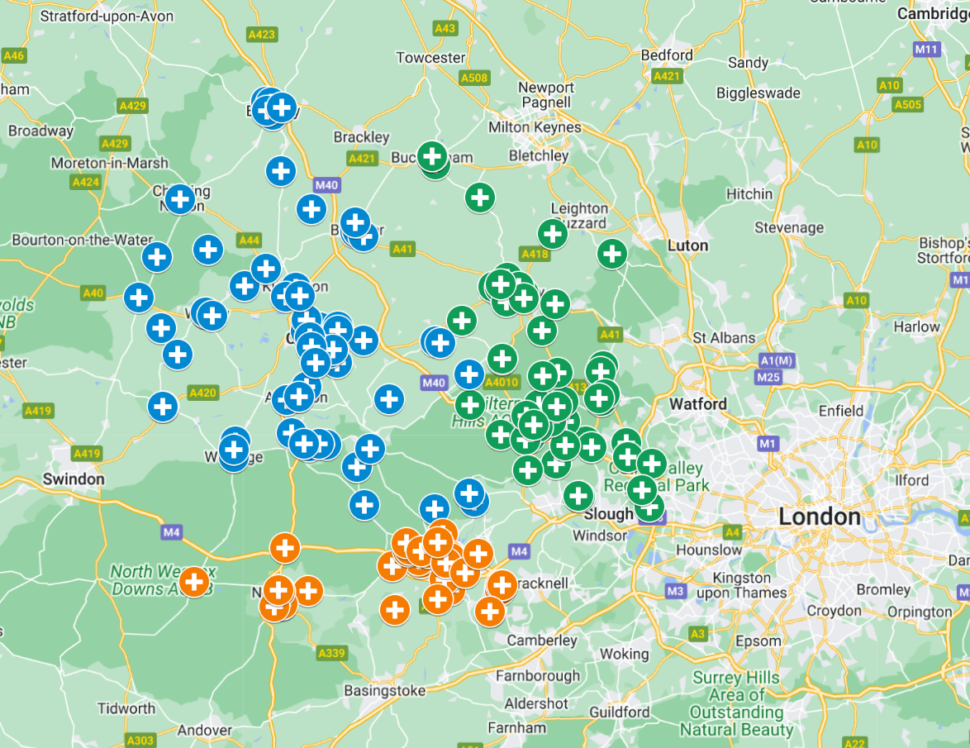
There is potential for greater LTC management in Community Pharmacy
Model of Care
Estates
Workforce
Processes
Technology
Information
Governance
Some Community Pharmacists have initiatives in place to identify patients with long term conditions. One example of this includes hypertension, where the NHS Community Pharmacy Blood Pressure Check Service supports risk identification and prevention of cardiovascular disease (CVD).
Identification
Assessment
Management
Pharmacists measure the blood pressure of adults who come into the pharmacy by offering anyone a free blood pressure check who appears to be over the age of 40 and has not previously been identified as having hypertension or their blood pressure measured in the last 6 months.
All blood pressure readings are sent to the general practice from the community pharmacy so records can be updated and appropriate action taken.
Pharmacists promote healthy behaviours and refer at-risk patients or those with suspected hypertension to general practice for ongoing management and care.
BOB ICB Community Pharmacy Blood Pressure Programme
The image on the left-hand side highlights those community pharmacies in BOB that conducted hypertension case finding in 2022. There were a total of:
64 in Buckinghamshire
63 in Oxfordshire
48 in Berkshire West
Hypertension case finding is part of the BOB ICB Community Pharmacy Blood Pressure Programme which aims to identify those over the age of 40 who have not previously been diagnosed with hypertension and to refer those with suspected hypertension to be managed appropriately. This initiative could be taken up by more pharmacies to conduct active case finding for hypertension
BOB ICB website

Slide 36





Good Practice on Prevention
Model of Care
Estates
Workforce
Processes
Technology
Information
Governance
Where systems, both globally, nationally, and within BOB, have made progress on prevention of ill health, they tend to have some or all of the features below, grouped into five core components. These cover 1) Primary prevention (e.g. vaccination) that stops ill health occurring, 2) Secondary prevention (e.g. screening or blood pressure management) that prevents ill health progressing or developing complications, and 3) Tertiary prevention (e.g. stroke rehabilitation or peer support) that minimises the impact of existing conditions. A more strategic and data driven approach to prevention is required to truly pivot Primary Care from a reactionary system focused on treatment towards a proactive system that focused on prevention.
Population Health Needs Analysis
Opportunity Analysis
Intervention Selection
Implementation and Evaluation
Commissioning and Incentive Alignment
The health needs of the population are analysed drawing on both qualitative and quantitative data – building a detailed profile of the population/cohort is important
Patients/Cohorts with similar health needs and at high risk are identified
A central PHM leadership team (with Local Authority, Public Health, Primary, Secondary and Community Care representation) is crucial.
A range of potential interventions for each cohort are identified
Each intervention is assessed according to its impact on health both now and in the future. Communication with patients is important to identify wider determinants of health that may impact their condition to build a full picture
Additional considerations include equality (so they don’t inadvertently worsen health inequalities) and finance (so they are cost effective).
Proposed interventions are then reviewed based on locally relevant factors e.g. scalability of intervention, level of integrated working required across the system. Costs and benefits will be assessed and the system should make a decision about the combination of activities it wishes to commission.
The final combination will depend on relative priorities for population health, outcome measures that are trying to be achieved and its financial/workforce constraints.
Interventions are implemented and their success evaluated.
Implementation is likely to require:
        A central Project Management Office (PMO)
      Funding streams to pay for the intervention
      Education and upskilling of staff in order to deliver the intervention
      Estates and facilities to deliver the intervention
      Agreed KPIs and progress monitoring
      Data collection and analysis tools
After evaluation it is necessary to determine whether an intervention should be terminated, amended, continued or scaled up
The initial outcome measures and KPIs attached to the intervention will enable successful evaluation
If the intervention is continued or scaled, the system may want to consider incentivisation. This would encourage other providers in the system to adopt the same practice, enhancing consistency of care across the system.

Slide 37
Summary of findings for Prevention
Model of Care
Estates
Workforce
Processes
Technology
Information
Governance
Primary Care supports people from the beginning to the end of life, and prevention and health promotion are key throughout. Whether it’s stopping people becoming unwell in the first place, preventing ill health progressing, or minimising the impact of poor health – all four Primary Care providers have a role: General Practice, Pharmacy, Optometry and Dentistry.
BOB is in a good position in terms of already having some excellent Population Health Management infrastructure in place in the form of the Connected Care / Graphnet risk stratification and segmentation tools.
There is work to do to expand this infrastructure across BOB, and then to support PCNs and wider partners to put the tools to use to gain insights into their local communities, design interventions in response, track impact, and stop or scale activity.
At Place level, prevention efforts are being targeted at narrowing inequalities by focusing on Core20Plus5 and partnering with the voluntary and community sector to support outreach efforts and the delivery of interventions.
Social prescribing is seen as valuable in providing a more holistic and less-medicalised approach where appropriate and could be spread and scaled.
BOB commissions a wide range of preventative interventions, including from community pharmacy, optometry and dentistry, but there are further opportunities to maximise the preventative role across all the pillars of primary care.
Whilst there are many examples of innovative partnerships between GPs, wider primary care, community services, mental health services and the voluntary sector, the overall approach is seen as opportunistic and fragmented rather than strategic and data-driven.

Slide 38
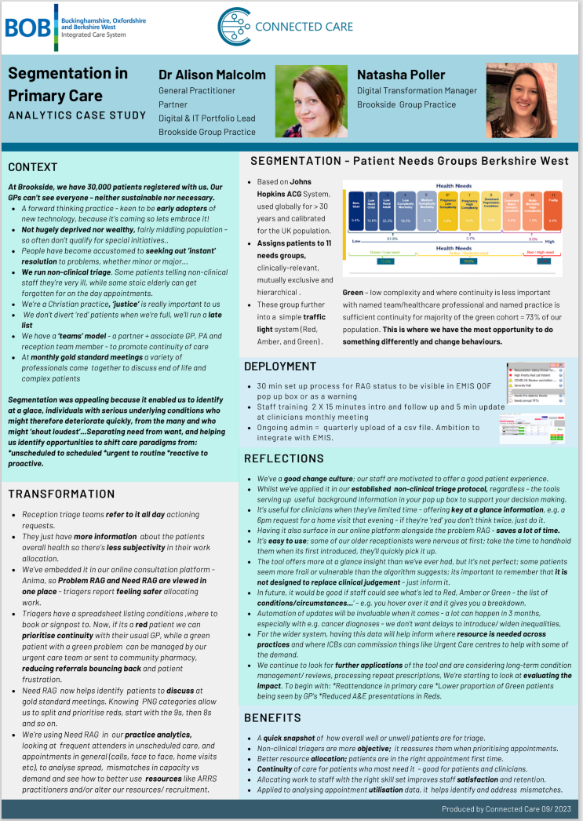
Work is underway to expand Population Health Management (PHM) infrastructure and apply the insights
Model of Care
Estates
Workforce
Processes
Technology
Information
Governance
Prior risk stratification and segmentation of patients could help improve both access and continuity as well as the prevention initiative
Within Berkshire West, the Power BI Connected Care Tool has been developed to enable Population Health Management. It is BOB’s ambition to build on this PHM infrastructure to enable more data driven decisions about the health services it provides in the future, such insights could potentially impact models of care for both access and continuity.
For example, PHM could transform access by allowing cloud telephony systems to identify patients at high risk and prioritise them for an appointment with their regular GP, rather than putting them through to an Access Hub. With regards to prevention, PHM data can highlight cohorts in the population who would benefit from more targeted interventions to either prevent ill health in the first place or prevent deterioration in those at risk.
Segmentation in Primary Care, Berkshire West
At Brookside Group Practice, they are using Graphnet’s “Segmentation” software which is able to risk stratify and segment the practice’s population according to the medical complexity. The system is based on Johns Hopkins ACG System and assigns patients to 11 needs groups which are further grouped into a simple traffic light system with green being low complexity and where continuity of care is less important (73% of Brookside’s population are green).
At the moment, two practices in Berkshire West are working closely with Graphnet and the ICB to understand the data and think about how they might use those insights to provide care differently – targeting support to those who need it most and preventing ill health.

Slide 39
There is a strong Place-based focus on inequalities and prevention
Model of Care
Estates
Workforce
Processes
Technology
Information
Governance
The Place Based Partnerships in BOB have a strong focus on inequalities, prevention, and wider determinants of health
Buckinghamshire
Oxfordshire
Berkshire West
Supporting Buckinghamshire’s ‘Opportunity Bucks’ programme, targeting the 10 most deprived areas, actions including health checks for people with severe mental illness, preconception and maternity support for highest risk ethnic communities.
In Oxfordshire, supporting specific communities including people who are homeless, building partnerships and increasing community capacity with VCSE and local partners to deliver local Core20PLUS5 initiatives.
Reducing premature mortality though community outreach programmes in Berkshire West with local, targeted actions including increasing health checks, BP monitoring and promoting ‘active medicine’.
General Practice has been involved with prevention initiatives by collaborating with partners across the system including VCSE
The Greater Reading Nepalese Community Association working with a cluster of GP practices in South Reading
Working closely with the New Reading PCN, the Greater Reading Nepalese Community Association is supporting a group of GP practices to help raise awareness of ‘Know your Numbers Week’ by hosting a Pressure Station at its football tournament to encourage visitors to get a blood pressure check and further support. The GPs, along with their surgery staff and local volunteers conducted 90 mini health checks over the course of the tournament, measuring BMI, blood glucose and blood pressure. The team were able to promote health and preventative healthcare advice and identify new cases of possible hypertension and diabetes.
Oxfordshire Mind – Local Mental Health Charity
Primary Care Wellbeing workers take a person-centred approach in the delivery of 1-1 sessions for people who are experiencing mental health issues or other social or lifestyle issues that are affecting wellbeing This service is available through participating GP practices in Oxfordshire and Wokingham. The individual can either self-refer into this service or speak to a GP/nurse at their local practice to be referred to the Oxfordshire or Wokingham Wellbeing Service.
“The service was very helpful and I feel like I am in a better place after speaking to you.”
Primary Care Service User

Slide 40
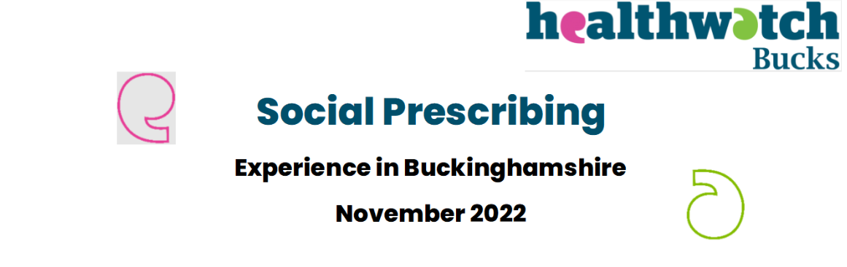
Social prescribing is seen as valuable in providing a more holistic and less-medicalised approach where appropriate, and could be spread and scaled
Model of Care
Estates
Workforce
Processes
Technology
Information
Governance
BOB Social Prescribing Link Workers
PCNs across the ICB currently provide social prescribing services in GP practices to support the wider determinants of health of BOB patients. PCNs currently employ approximately 110 Social Prescribing Link Workers. The social prescribing team have significant relevance as they are able to identify solutions and support patients to access services quickly, ensuring they get the care they need. Due to their broad experience including knowledge of social challenges they can better support health often in a non-medicalised way. Anecdotally, this has resulted in reductions in demand for GP appointments.
ARRS data shared by ICB
Berkshire West Case Study
In Wokingham, there was an increasing number of complex patients with complex co-morbidities whose care was fragmented. Too often, patients were having multiple contacts with different professionals. Their vision was to provide a seamlessly joined up experience for patients to improve health outcomes and to use proactive interventions to help patients live well and independently for longer. Linked data-sets were used to identify patients that were most in need and a MDT team worked together to personalise their care. Enhanced health checks and assessments were offered and social support such as help with shopping and exercise. Additionally, certain patients were discussed at virtual MDT and offered a personalised plan including a community matron review if appropriate and social prescriber support. For the total patient cohort (excluding patients who passed away or moved out of the area), there were 176 fewer non-elective admissions and 270 fewer A&E attendances in the six months following intervention compared to the six months before.
Further, Wokingham Council have been supporting the roll-out of a social prescribing app called JOY. In the last year, Project JOY has supported more than 3,000 service users within the borough and has seen a 23 per cent reduction in GP appointments (Wokingham Borough Council).
Many respondents said they found speaking with a social prescriber helpful and appreciated their time and support – though there were some issues with getting more support afterwards.
Healthwatch Buckinghamshire Report

Slide 41
BOB commissions a wide range of preventative interventions, and the remit of community pharmacy, optometry and dentistry could be extended
Model of Care
Estates
Processes
Workforce
Technology
Information
Governance
There are various primary prevention initiatives in place which involve a wide range of stakeholders across primary care:
Community Pharmacies
Pharmacies provide a range of prevention services in BOB including both NHS commissioned services and privately provided / self-pay ones. There is variation in the extent to which Community Pharmacies offer this range of services.
With the devolution of POD Commissioning, there is an opportunity to expand the remit of Community Pharmacy services and integrate them better with PCN and ICS wider plans and services.
Smoking - increase capacity of smoking cessation services across BOB and increase referral from all practices to smoking cessation services
Weight Management – targeting activity where prevalence is highest; ensure those in deprived areas are referred to weight management services; increase referrals from all PCNs to these services
Physical Activity – support place-based multi-agency partnerships to improve physical activity levels and reduce obesity.
Drug & Alcohol Use – increase data collection and understanding around alcohol consumption
Vaccinations – increase the provision of hepatitis vaccination, screening, increase uptake of immunisations in primary care for those who leave school without completing their immunisations, and uptake of vaccination against COVID and flu for pregnant women
Mental Health – earlier intervention initiatives for Children and Young People and Adults.
Essential Services
Advanced Services
Dispensing Medicines
Dispensing Appliances
NHS Discharge Medicines Service
Repeat dispensing / electronic repeat dispensing (eRD)
Disposal of unwanted medicines
Managed repeats
Public Health (promotion of healthy lifestyles)
Signposting
Support for self care
Stoma Appliance Customisation Service
Appliance Use Review Service
Community Pharmacist Consultation Service
Flu Vaccination Service
Hypertension Case Finding Service
New Medicines Service Smoking Cessation Advanced Service
NHS Pharmacy Contraception Service Tier 1
Joint Forward Plan 2023
Optometrists: provide a range of prevention services in BOB including both NHS commissioned services and privately provided / self-pay ones.
Dentists: can provide a range of preventative functions to reduce the incidence of ill health – both in terms of oral care e.g. brushing and flossing to prevent tooth decay – and more broadly opportunistic health advice on alcohol and smoking, and opportunistic screening for oral cancer. However, people report issues with access to dental services so these opportunities may not be maximised.

Slide 42
2. Estates

Slide 43
Summary of findings on Estates
Model of Care
Estates
Workforce
Processes
Technology
Information
Governance
Rethinking the Primary Care estate was a key recommendation in the Fuller Stocktake, with ICSs asked to conduct an audit of existing NHS and Local Authority estate with a view to working together on plans for future use as part of a “One Public Estate” strategy. The key findings for Primary Care estate in BOB are described below:
Primary Care estate is becoming less fit for purpose over time, with converted houses and older developments making up a significant proportion.
The ICB has taken steps to understand the stock of Primary Care estates, and future requirements of General Practice, but the outputs are undergoing further validation.
Funding and local planning rules make it difficult to improve primary care estate.
There are estates strategies for Buckinghamshire and Oxfordshire but there isn’t an available strategy for Berkshire West.

Slide 44
Primary Care estate is becoming less fit for purpose and efforts to understand current stock and future needs require validation
Model of Care
Estates
Workforce
Processes
Technology
Information
Governance
Primary Care Estates are becoming less fit for purpose over time
Population growth: The population of BOB is growing, with many new developments built or planned in the near future. Around 110,000 additional residents are expected in Oxfordshire by 2028 for example, but despite this, there have been limited new premises extensions / developments in BOB over the past several years. Some General Practices report that they are already utilising their clinical space at maximum capacity, with virtual consultations being undertaken in admin space. In BOB, GPs reported only being able to offer 1/3 of possible training capacity due to space constraints, impacting the growth of the future GP workforce.
Model of Care: The model of care is also forecast to change with a move to more virtual consultation and more integrated working with Community and VCSE partners in future. Many practices would like space to expand their service offer but are constrained by the lack of availability of rooms. PCNs will increasingly require physical clinical space to absorb ARRS staff increase and those working from home will require robust IT infrastructure.
State of repair: In some places, the estate is also in need of repair or regeneration. In a national survey, ~2,000 of 8911 GP premises were identified by GPs as not being fit for purpose.
The ICB has taken steps to understand the stock of, and future requirements of, Primary Care estates but this requires validation
NHSE provided ~£500k of funding to conduct a national independent audit of estate and also supplied a toolkit to aid the process. The process to undertake the assessment was lengthy and required extensive data input and feedback from system leaders and GPs was that further validation and support is needed for the toolkit to have impact:
Population estimates: While changes to population growth were considered in the calculations, distribution of demand (based on planned new developments etc) were not
Model of care: Trends in Primary Care delivery models were not considered as part of the projections - move to Integrated Neighbourhood Teams, provision of same day access at-scale, broader scopes of practice for community pharmacies etc)
Units of measurement: An estimated cost per square metre of floor space that was too low
Validation: PCNs were asked to estimate their future estate requirements without having reference to wider system plans for the model of care or other factors impacting estate's needs, and without external validation of their estimates.
Buckinghamshire and Oxfordshire have developed estates strategies in the last 2-3 years that provide the information on subsequent pages; no similar document has been received for Berkshire West.

Slide 45
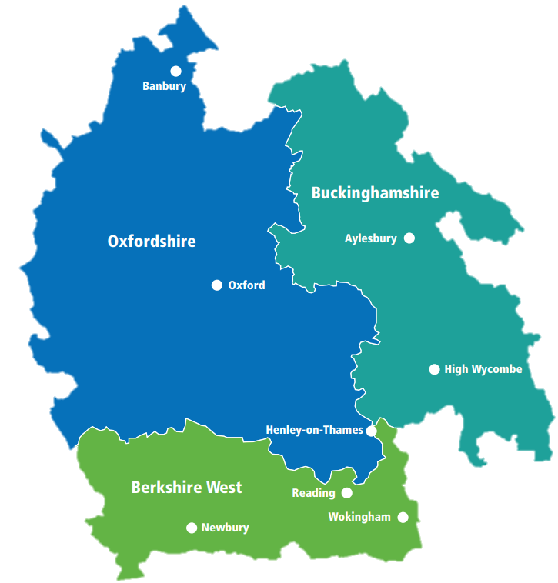


Current estates landscape: Oxfordshire (2020)
Model of Care
Estates
Workforce
Processes
Technology
Information
Governance
The key areas for developments due to the expanding housing growth and subsequent population rise
Approx. 18 Patients per m²
13
Practices have their lease expiry date or a break clause within the next five years. Nine have their lease expiry date or a break clause within the next ten years.
67
general practices (formed into 20 PCNs)
Bicester
Oxford
Of the 67 practices, there are 83 practice buildings, not including five village halls or other such buildings, and of these approximately:
Didcot
Wantage
40%
£11,803,538
The Primary Care delegated co-commissioning budget for GP Premises is currently £11,803,538 pa. This is part of a wider primary care delegated budget.
There are 5 practices that have a list of 5,000 or less
Non-optimal estate with approximately a quarter of the estate in converted houses and 40% of the estate in purpose built buildings more than 20 years old.
There are 9 practice branch buildings which are less effectively utilised than main surgery premises
*approximately 60% of the purpose built surgeries being more than 20 years old
Oxfordshire Primary Care Estates Strategy (2020)

Slide 46
Current estates landscape: Buckinghamshire (2021)
Model of Care
Estates
Workforce
Processes
Technology
Information
Governance
The key areas for developments due to the expanding housing growth and subsequent population rise
Approx. 23 Patients per m²
1/3
of the estate in converted houses and the majority of the remaining estate in purpose-built buildings generally more than 20 years old.
48
general practices (formed into 13 PCNs)
Buckingham
Aylesbury town
Of the 48 practices, there are 84 practice buildings, not including village halls or other such buildings used for occasional sessional clinics, and of these approximately:
70%
Wycombe Town
£6,321,408
The CCG Primary Care delegated co-commissioning budget for GP premises is currently £6,321,408 pa (2021 / 2022).
There are a number of smaller practices with a list size of less than 5,000.
About 70% of practices have higher numbers of patients per m2 than the indicative level meaning that practices are already managing with less space than recommended
There are a number of lease expiry dates within the next five years.
*approximately 50% of the purpose-built surgeries being more than 20 years old
Buckinghamshire Primary Care Estates Strategy (2021)

Slide 47
Funding constraints make it difficult to improve the primary care estate
Model of Care
Estates
Workforce
Processes
Technology
Information
Governance
Planning Rules and Funding Issues
Funding the development of Primary Care (General Practice) estate
The ICB does not hold capital funding to invest in general practice properties. Any development therefore needs to be subject to a bid to NHS England, funded through developers' contributions or through rent reimbursement. The revenue consequences of new buildings are funded through the delegated primary medical services budget which does not take account of expected population growth.
Development of new Primary Care estate
Funding new Primary Care estate has also been fraught with issues. When building new GP surgeries, building companies require assurance that they will get a good rent for the space, and that rent is guaranteed over a long period of time (normally 25 years) - they need to be sure that furbishing it to NHS requirements is worth the investment. However, this approach can pose number of issues, examples of which have been seen in Bicester and Didcot:
Length of lease: the current partnership model can make it too financially risky for practices to sign up to leases that are longer than 5-10 years. This is not long enough for the building contractors / owners to receive a return on their investment to create a new building
Reimbursement Rate: The reimbursement rent as determined by the District Valuer is often too low to secure the use of new estate for NHS purposes.
Local Authority Property transactional rules Even if the NHS was to make an exception and agree to fund NHS premises in conjunction with Local Authorities, such Authorities have rules around “best value” when disposing of that real estate (whether leasehold or freehold), even if it was gifted to them through developers' contributions. Thus for example, a site gifted to a Local Authority under a Section 106 Agreement for Health infrastructure development, cannot then be transferred across to the NHS at nil value either directly or indirectly (if the Local Authority was to act as a developer of the premises)
Planning rules specific to healthcare estate: For non-healthcare facilities, the Town Planning process would allow LAs to borrow money, build and then claim the money back through a section 106 agreement. This is not an option for healthcare, so healthcare estate is often low priority for developers' contributions, often below schools and roads.
Options suggested with regard to the development of Primary Care estate in BOB
The ICB guaranteeing the length of the lease or for GP practices to work at scale (e.g. as part of an Alliance) and form a company that would be able to take on the lease.
A clear expectation could be set that the public estate should be used flexibly including to support primary care, working in an integrated way with other parts of the system.

Slide 48
3. Workforce

Slide 49
Model of Care
Estates
Workforce
Processes
Technology
Information
Governance
Summary of findings on Workforce
Availability of sufficient, appropriately trained, empowered and motivated staff across a range of workforce groups is essential to the successful delivery of primary care. This section outlines findings from discussions with stakeholders on the current Primary Care workforce in BOB and analysis based on available data, to seek to understand factors impacting the size, shape and nature of the workforce.
General Practice, Pharmacy and Dentistry colleagues reported extreme workloads and pressure.
Oxfordshire has higher numbers of GPs and Nurses for its population than Berkshire West and Buckinghamshire.
Full time equivalent GP numbers have been stable over the last two years, with a decrease in the proportion of Partners.
Numbers of other staff, especially those providing direct patient care, have increased over the last 2 years.
The proportion of patients seen by GPs versus other practice staff has reduced slightly over the last 4 years, especially in Berkshire West.
Recruitment to ARRS roles has been successful, though significant time is required for supervision and when lacking, impacts retention.
Retention of experienced General practice staff is a concern with a high proportion nearing retirement age.
Pharmacy and Dentistry also face challenges with recruitment and retention of staff.
Primary care workforce development and planning lacks system-wide strategic focus.

Slide 50
Oxfordshire has higher numbers of GPs and Nurses for its population
Model of Care
Estates
Workforce
Processes
Technology
Information
Governance
Numbers and skill mix of the Primary Care workforce across BOB
Oxfordshire
Buckinghamshire
Population: 726,000
GP FTE: 502 (7)*
ARRS FTE: 374 (5)*
Nurse FTE: 188 (3)*
Population: 544,000
GP FTE: 315 (6)*
ARRS FTE: 261 (5)*
Nurse FTE: 133 (2)*
Berkshire West
Population: 533,000
GP FTE: 276 (5)*
ARRS FTE: 283 (5)*
Nurse FTE: 112 (2)*
* Figures in brackets show rates per 10,000 population
NHS Digital General Practice Workforce, 31 August 2023
BOB ARRS Workforce Planning Data 2023

Slide 51
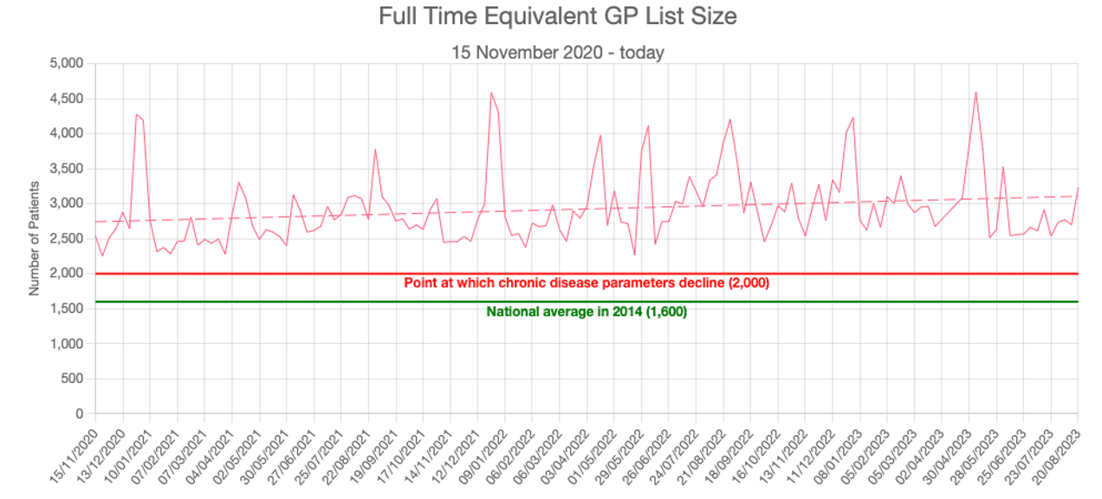
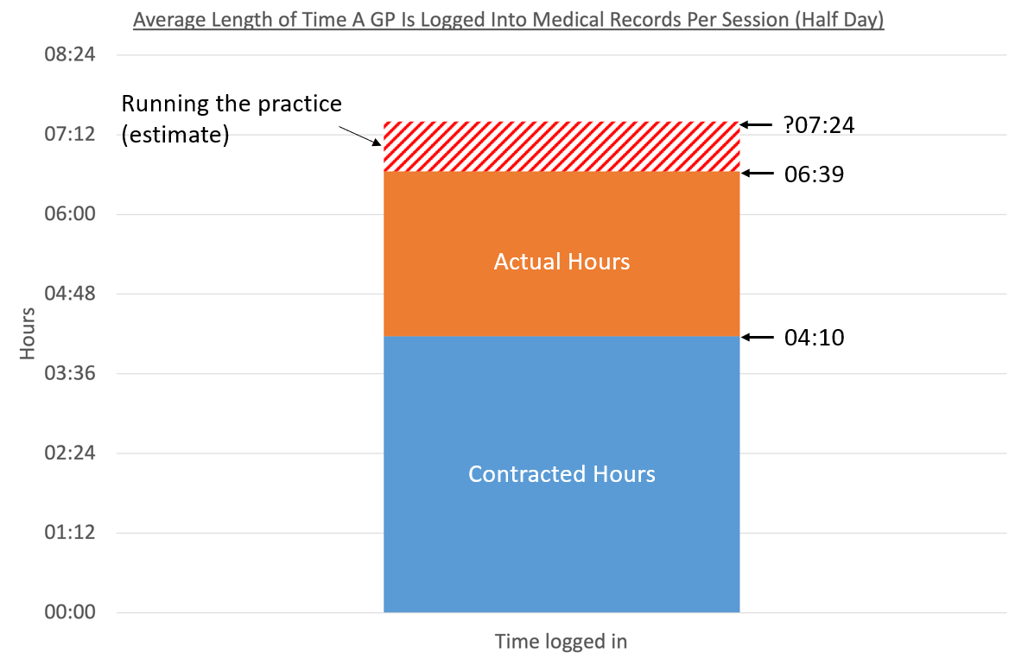
General Practice, Pharmacy and Dentistry colleagues reported unsustainable workloads and pressure
Model of Care
Estates
Workforce
Processes
Technology
Information
Governance
Across England and globally, primary care is known to be under significant pressure from rising demand combined with funding and workforce constraints, this message came through very strongly in engagement across BOB. This was particularly from General Practice, but also Community Pharmacy, Dentistry and to some extent Optometry. Within General Practice, colleagues described the unsustainable pressure they experience. Contributory factors were felt to include a rising administrative burden (perhaps due to pressure in other parts of the system) and greater complexity of patient need (social as well as medical) – data on acuity and presenting need was not available for analysis.
Clinical workload is increasing for GPs across BOB
GPs are working significant overtime
The LMC provided data showing average patient list size per GP FTE (assuming an FTE GP works 9 sessions a week). They expressed concern that average patient list size has increased steadily over time and is above what is considered safe with respect to chronic disease parameters (around 2000 patients).
The LMC also expressed concern at the amount of overtime being worked by GPs – including both clinical and administrative work. This chart shows LMC estimates of the time over and above contracted hours that GPs typically perform in a session (half day).
Estimated overtime
Graphs taken from Berkshire, Buckinghamshire and Oxfordshire LMCs

Slide 52
Full time equivalent GP numbers have been stable over the last two years
Model of Care
Estates
Workforce
Processes
Technology
Information
Governance
Overall FTE are stable while the proportion working between 15 and 37.5 hours per week has increased
Number of GP Partners has reduced slightly, while salaried and trainees have increased, and number of locums has slightly decreased. There is an increase in those working part-time. Discussions with GPs in our focus groups indicated that high workloads in General Practice might be contributing to this, as well as a desire to diversify workload with clinical work in other settings - the Community Gynaecology Service in Oxfordshire was cited as a good example of this.
KPMG analysis of NHS Digital Data

Slide 53
Numbers of other staff, especially those providing direct patient care, have increased over the last 2 years
Model of Care
Estates
Workforce
Processes
Technology
Information
Governance
Staff providing direct patient care (not GPs or Nurses) have increased by 14%
Nurse FTE have increased by 4% while admin/non-clinical staff have increased by 5%, and other staff providing direct patient care have increased by 14% since December 2021.
KPMG analysis of NHS Digital Data

Slide 54
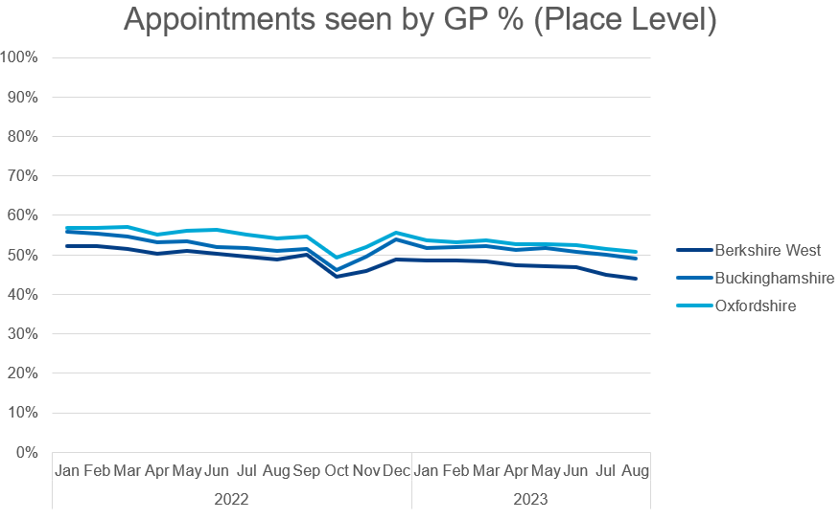
The proportion of patients seen by GPs versus other practice staff has reduced slightly over the last 4 years
Model of Care
Estates
Workforce
Processes
Technology
Information
Governance
GP Appointments across BOB by staff group
48% of total consultations were seen by a GP in August 2023 compared to 53% in August 2019. This trend is most pronounced in Berkshire West.
KPMG analysis of NHS Digital Data

Slide 55
Recruitment to ARRS roles has been successful, though retention is challenging
Model of Care
Estates
Workforce
Processes
Technology
Information
Governance
There has been significant recruitment into ARRS roles but uptake across PCNs is mixed
PCNs currently employ approximately around 919 FTE ARRS staff across BOB. These roles, including health coaches, care coordinators and link workers, have contributed greatly to PCNs being able to offer a social prescribing service. However, feedback from our GP focus groups indicated that there has been variation of uptake across the patch.
Even where uptake of ARRS roles has been good, turnover has been high. There has been a stark fall in the number of ARRS roles in BOB recently with a 50% drop in social prescribing link workers, a 21% drop in phlebotomists, and a 13% drop in Paramedics between December 2021 and 2022 (NHS Digital).
Feedback from GP focus groups indicated this might be a result of their roles not being fully integrated into General Practice work and also due to a lack of peer support and supervision.
“ARRS staff have proved to be a really valuable asset and enhanced clinical teams”.
“Time is required to train and mentor ARRS staff and this has to be done on top of the clinical workload.”
Practice Manager, Focus Group
GP, Focus Group
KPMG Strategic Workforce Data analysis – data from NHS Digital

Slide 56
Retention of experienced staff in General Practice is also challenging
Model of Care
Estates
Workforce
Processes
Technology
Information
Governance
Many staff are approaching retirement age, especially nurses
GPs expressed concern about a decline in experienced practice nurses and significant challenges in recruiting to posts. The proportion of nurses, staff providing direct patient care and admin/non-clinical staff who are over 55 in BOB is higher than the national averages.
Five Year Age Bands for major staff groups
Area | Staff Group | <25 | 25-29 | <30 | 30-34 | 35-39 | 40-44 | 45-49 | 50-54 | 55-59 | 60-64 | 65+ | Unknown | % Over 55
BOB ICB | Admin/Non-Clinical | 151 | 133 | 284 | 149 | 134 | 149 | 185 | 291 | 416 | 351 | 185 | 29 | 44%
BOB ICB | Direct Patient Care | 17 | 48 | 65 | 72 | 73 | 70 | 97 | 70 | 77 | 62 | 21 | 2 | 26%
BOB ICB | GP |  |  | 76 | 178 | 201 | 166 | 147 | 136 | 116 | 60 | 11 | 4 | 17%
BOB ICB | Nurses | 4 | 24 | 28 | 31 | 35 | 49 | 48 | 71 | 72 | 63 | 23 | 8 | 37%
South East | Admin/Non-Clinical | 833 | 822 | 1655 | 826 | 816 | 853 | 1005 | 1639 | 2092 | 1769 | 912 | 96 | 41%
South East | Direct Patient Care | 87 | 186 | 274 | 312 | 332 | 290 | 352 | 356 | 382 | 271 | 112 | 22 | 28%
South East | GP |  |  | 228 | 808 | 904 | 857 | 779 | 646 | 550 | 309 | 117 | 25 | 19%
South East | Nurses | 22 | 129 | 151 | 178 | 216 | 260 | 310 | 420 | 464 | 316 | 122 | 44 | 36%
England | Admin/Non-Clinical | 6257 | 6543 | 12800 | 6364 | 6164 | 6165 | 6621 | 10256 | 11913 | 9588 | 4573 | 806 | 35%
England | Direct Patient Care | 662 | 1705 | 2366 | 2044 | 1974 | 1888 | 1862 | 2103 | 2125 | 1481 | 557 | 274 | 25%
England | GP |  |  | 3221 | 6152 | 6504 | 5584 | 5103 | 4211 | 3418 | 1743 | 1112 | 320 | 17%
England | Nurses | 171 | 906 | 1077 | 1400 | 1655 | 1964 | 2132 | 2705 | 2871 | 1946 | 720 | 498 | 33%
KPMG analysis of NHS Digital Data, October 2023

Slide 57
Recruitment and retention challenges are also present in Pharmacy and Dentistry
Model of Care
Estates
Workforce
Processes
Technology
Information
Governance
Pharmacy
Pharmacies are facing workforce challenges and many are operating with locum staff
Pharmacists were enthusiastic about providing a greater range of services but reported that they are limited by their workforce numbers. Some noted that it can be challenging to recruit pharmacists into privately owned practices when competing with roles within general practice as these are sometimes seen as more desirable. Within the Community Pharmacy Workforce Survey 2022, 67% of respondents said it is very difficult to fill vacant roles for pharmacists.
Pharmacists play a critical role in the community but many do not have prescribing skills
For the majority of pharmacists, current care provision includes dispensing medicines and managing chronic conditions e.g. supporting with health screenings and flagging when patients need to see their GP or require other care. Changes to education and training mean that from September 2026, all newly qualified pharmacists will be independent prescribers and therefore their responsibility in providing patient care is increasing. There will be a need to fund upskilling of community pharmacists so that they can deliver more services – currently 3,000 independent prescribing courses are being offered to existing community pharmacists.
Optometry
Participants of the optometry focus group stated that there are no workforce shortages but more services could be delivered by optometrists if better remunerated. Optometrists would welcome the opportunity to upskill and provide more community care. Therefore, the ICB might want to wish to consider subsidising training such as that which provides Minor Eye Conditions Service (MECS) accreditation.
Dentistry
General Dentistry Services (GDS) and Community Dentistry Services are finding it difficult to recruit staff
Dentistry staff reported that “it is very difficult to recruit and retain staff – both dentists and dental nurses in GDS”. It’s believed this is because staff prefer to work privately because the remuneration is better. Staff fed back that the new workforce who are joining GDS are typically inexperienced dentists who can struggle to deal with complex dental cases. Community Dentists told us that it is very difficult to recruit specialist dentists at the moment and that many specialists are currently based in dental hospitals or working privately. Dentists mentioned that there is a variation in the Unit of Dental Activity (UDA) rates offered to practices in BOB, and that practices with a more attractive UDA rate usually recruit and retain staff more easily.
The partnership between Berkshire Healthcare, Oxford Health and Central and North West NHS FT has enabled the dentistry workforce to move around the three trusts and resulted in streamlined processes and a reduction of costs (Thames Valley Community Dental Services).

Slide 58
Primary care workforce development and planning lacks system-wide strategic focus
Model of Care
Estates
Workforce
Processes
Technology
Information
Governance
Training and development
Locally developed training and protected time to attend courses would be welcomed
There are programmes of work underway in BOB to help with targeted upskilling of the Primary Care workforce. For example, the Personalised Care team in BOB have an in-house training team who are working with ARRS Professionals in Primary Care on skills required for personalised care such as motivational interviewing; there is Care Navigation training ongoing for reception and admin teams in General Practice (part of national NHSE Signposting Training); and there is also training as part of an NHSE Intermediate QI Programme.
However, General Practice staff reflected that more localised training opportunities, as well as protected time to release staff to go on the training courses, would be beneficial. Some practices are finding that administrative staff often leave before they are able to offer development opportunities to them.
Additionally, practices reflected that time is required for supervision and training ARRS staff. One practice stated “there is a large training commitment with ARRS staff and limited time to carry this out.” Responses in the survey indicated that much of the mentoring and training of ARRS staff is taken on by GPs.
Strategic Workforce Planning
There is a requirement for primary care workforce planning, integrated with secondary care at system level
BOB ICB monitors trends in workforce as one of 7 key quality and performance indicators in the Quality and Performance Report (the others include Urgent and Emergency Care, Elective, Mental Health, Cancer, Primary Care Access, and Quality). System leaders in BOB highlighted a need for a system-wide approach to workforce planning that considers the impact of technology, new models of care and new integrated working patterns that span primary, secondary and community care.
.

Slide 59
4. Processes

Slide 60
Summary of findings on Processes
Model of Care
Estates
Workforce
Processes
Technology
Information
Governance
In this section, we describe the front, middle, and back-office processes already in place to support Primary Care access in BOB, and ways in which those processes may need to evolve to support new ways of working:
There is variation between practices in their approach to front, middle and back-office functions and much activity is not patient-facing.
Standardisation of front, middle and back-office functions in General Practice can facilitate at-scale integrated working.

Slide 61
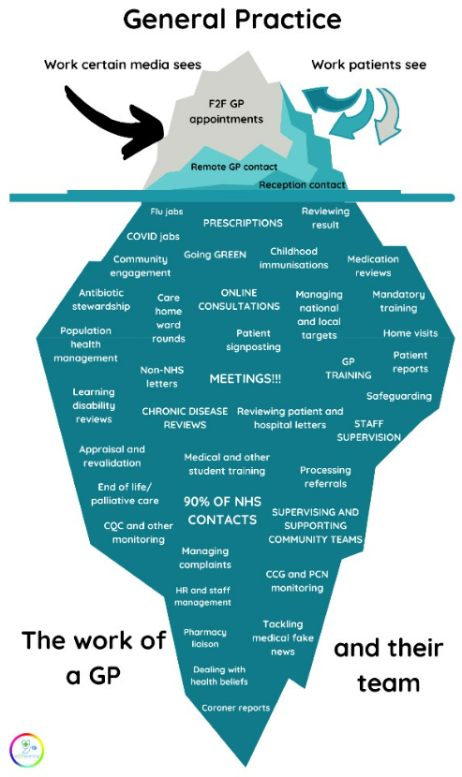
There is variation between practices in their approach to front, middle and back-office functions and much activity is not patient-facing
Model of Care
Estates
Workforce
Processes
Technology
Information
Governance
GPs describe how a significant proportion of their daily activities is unseen. Streamlining back, middle and front office processes could release capacity for higher value clinical work. Oxfordshire is working with Secondary Care on interface issues and how they could work more efficiently together.
Front Office processes
Standard Operating Procedures: Although practices increasingly work together – either as part of Primary Care Networks or part of larger federations or alliances – there is variation in their approach to front-line processes. An example of this the approach to triage and navigation where the data indicate that some practices are more inclined to give face to face appointments than others. Providing an at-scale triage and navigation function will require alignment between practices on their approach, codified in a shared Standard Operating Procedure.
Standardised Clinical Pathways: Shared clinical pathways facilitate collaborative working between General Practice and other clinical providers including acute, mental health and community services. These will become increasingly important as BOB works towards developing Integrated Neighbourhood Teams. Some shared clinical pathways exist through the work of the Long Term Conditions Team and this approach could be scaled.
Middle Office processes
Middle office functions are activities that drive quality, performance and transformation in general practice. These include workforce development, continuous quality improvement, and population health management. These activities happen outside of clinical sessions and require dedicated time. This is another area however, where an at-scale approach e.g. at a PCN, place or even system level, could be beneficial. Some of this work is happening at a PCN level where PHM data is fed back to them but at present many lack the capacity to act on that data or those insights.
Back Office processes
Back office functions include activities such finance, payroll, human resources, administration and procurement, and are repeated in practices across BOB. In global good practice, there is a trend towards consolidation of back-office functions often at a PCN level (e.g. in Australia) or at a federation level between practices (e.g. Modality Group in the UK). This is something practices could consider as they progress to more at-scale working or something the ICB could offer to do at scale e.g. procurement of new software for all practices.
EGPlearning

Slide 62
5. Technology

Slide 63
Summary of findings on Technology
Model of Care
Estates
Workforce
Processes
Technology
Information
Governance
This section consider the use of supporting technology for clinical decision making, importance of interoperability and resolution of informational governance issues. The model for Primary Care will require a digital infrastructure to underpin all new services and processes, which should be a part of the working lives of staff and easy to use for patients.
There are multiple digital triage platforms being used, leading to variation and higher costs to the ICS due to multiple procurements.
Whilst digital triage and video consultation systems are available in most practices, in many cases the access pathway to general practice has not been updated and could be optimised.
This would enable more effective triage processes to direct patients to the right service and right practitioner, potentially using robotic and AI technology.
Video consultations could also be offered as a standard for same day consultations to provide additional capacity (and reduce pressure on estates).
The majority of practices use EMIS, however there are currently three Electronic Patient Record (EPR) systems being used in the ICS. This creates barriers when trying to collaborate with PCNs and implement services at scale across practices.
Bringing the system onto one EPR would provide the opportunity for cross PCN working with the ability to log into EPRs securely across multiple sites using cloud technology and VPNs.

Slide 64
There are varied technology enablers in place across BOB
Model of Care
Estates
Workforce
Processes
Technology
Information
Governance
The current state landscape of the technology enablers for General Practice within BOB ICB was informed by: Interviews with senior staff and delivery teams within BOB ICS technology team; and review of the design of the ICB digital and data strategy and governance structure completed outside of this programme. This table provides an overview of the current technology solutions available in BOB to enable the delivery of key business capabilities for General Practice.
Business Capability
Current Solution Landscape
Patient Channels
Telephony
Web
Mobile
Video Consultations
Analogue Telephone Lines
Cloud Telephone Lines
Triage Platforms Below
Practice Website
NHS App
AccuRx
Care Management
Triage/Online Consultations
Remote Monitoring / Management
eConsult
Footfall
Askfirst
AccuRx
Anima
EngageConsult
Medilink
KLINK
AccuRx
Graphnet
Care Delivery
Electronic Patient Record
Prescribing
Shared Care Records
EMIS
Vision
SystmOne
NHS Electronic Prescriptions Service (EPS)
Summary Care Record (SCR)
Thames Valley and Surrey Care Records
Workflow & Care Integration
Diagnostics
Referral Management
Digital Point of Care Testing
NHS Electronic Referral Service (e-RS)
Digital Workplace & Infrastructure
Communications
Connectivity
SMS Services
NHS App
AccuRx SMS Services
PDS (NHS Spine)
N3 Network
HSCN
Workforce Management
HR & Payroll
Manual HR Filing
Outsourced Payroll
Key:
Front Office
Back Office
Long Term Care Mgt

Slide 65
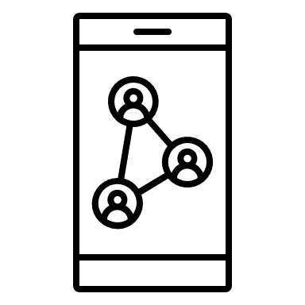

There is variation in type and uptake of front office technology solutions
Model of Care
Estates
Workforce
Processes
Technology
Information
Governance
Partial Adoption Of Multiple Digital Triage Platforms
Across the ICS there are multiple digital triage products being used to support general practices to manage incoming demand. There is variation in how these platforms are being used, with some practices only partially utilising the technology, which is limiting the realisation of benefits. The products were rapidly adopted into practices, which has meant both the local processes and staff roles were not always updated and adapted to allow the new to be embedded in a way that can streamline processes and deliver benefits for staff and patients.
Cloud Telephony Rolled Out Across The Majority Of General Practice
150 out of 157 GP practices have moved over to cloud telephony which enables working at scale across multiple sites, with the primary care workforce enabled to access their telephony system across various devices including mobiles, desktops and tablets, ultimately delivering quicker and more seamless access for patients. Practice Managers gave some positive feedback about the benefits of cloud telephony.
Low Uptake Of Virtual Consultation Platform
The AccuRx system which is predominately installed across BOB is primarily used by GP practices to enable clinicians to assess patients via a video consultation. Usage of the system has dropped since face to face appointments have become available again after Covid. GP staff report that there is a lack of appetite for virtual consultations from patients and staff.
Using Remote Monitoring Solutions To Collect PROMS (Patient Reported Outcome Measures)
To support the continuous monitoring of patients with long term conditions BOB has the AccuRx and Graphnet remote monitoring systems in place. These give clinicians and patients information that would normally be obtained and recorded in a face to face setting.
Alternative Ways To Message Patients
To support practices to communicate with their patients via SMS texting the ICB procured AccuRx. This enables practices to remind patients about their appointments and to collect information relating to their clinical conditions.
* Data provided by BOB ICB
Video Consultation Solution Usage
All 157 practices in BOB have installed AccuRx Video consultation platform, over time there has been a declining usage of the system. GP staff report that there is a lack of appetite for virtual consultations from patients and staff.

Slide 66
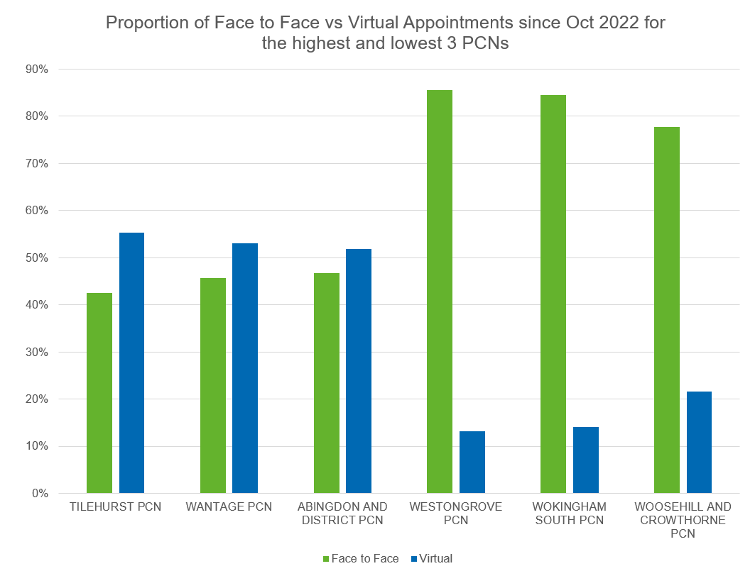
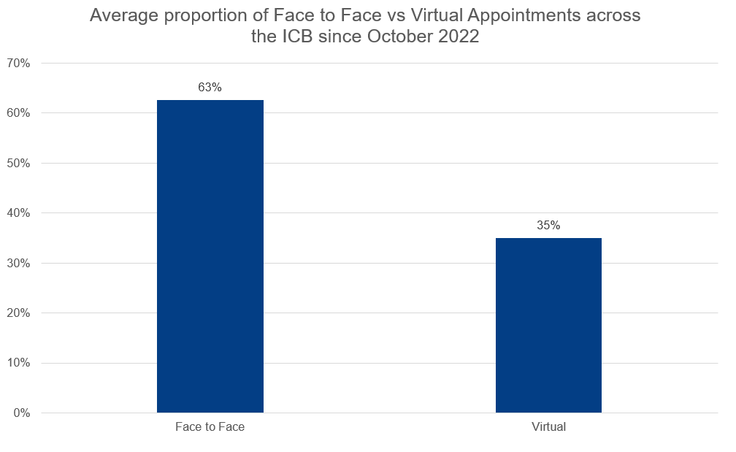
Face to Face appointments account for around 2/3 of all GP appointments
Model of Care
Estates
Workforce
Processes
Technology
Information
Governance
Around 2/3 of GP appointments are Face to Face and 1/3 over the phone
There is variation between PCNs in their use of technology for remote consultation as they are serving different populations...
KPMG analysis of data shared by ICB & NHS Digital

Slide 67

There is variation in type and uptake of back-office technology solutions
Model of Care
Estates
Workforce
Processes
Technology
Information
Governance
Multiple Electronic Patient Record Systems
The are three electronic patient records (EPR) platforms in use for General Practice in BOB: EMIS, Vision and SystmOne. There are 152 on EMIS Practices, 2 on Vision and 3 on SystmOne (TPP). All systems have the ability to code patients’ clinical status which supports population health management, and management of incentive schemes such as QOF and Enhanced Services.
Lower Than Average Use Of Electronic Referrals
The majority of practices in BOB are signed up to the NHS e-Referral Service (e-RS), and e-RS is built into the EPR’s functionality. The e-RS system enables patients to monitor their referral progress and sometimes choose a secondary care provider of their choice. National data shows over 8000 referrals were made to secondary care providers via the system on average over a 4-week rolling period. This is lower than the usual average ICB1.
Electronic Prescribing Not Being Fully Utilised
Through the use of local electronic patient record systems over 1.9m patients in 96% of GP practices BOB are able to have their prescriptions electronically prescribed and issued via the Electronic Prescription Service (EPS), which transfers the prescription to the patient’s pharmacy of choice to be dispensed. However, the system has an 84% utilisation rate (approx. 2 million prescription items) meaning manual prescription items are still being issued to pharmacies/dispensaries for the other 16% (approx. 300k prescription items).
*Data analysis provided by BOB
1,eRS data source - https://digital.nhs.uk/dashboards/ers-open-data
2,EPS data source - https://digital.nhs.uk/data-and-information/data-tools-and-services/tools-for-accessing-data/deployment-and-utilisation-hub/electronic-prescription-service-deployment-and-utilisation-data

Slide 68
6. Information

Slide 69
Summary of findings and opportunities on Information
Model of Care
Estates
Workforce
Processes
Technology
Information
Governance
Information (or data and analytics) can be used across the system and within organisations to help with the following: 1) Understanding the health and social care needs of the population, 2) Planning services, 3) Delivering services and 4) Monitoring and evaluating progress – both from a quality and performance perspective. In reviewing data and analytics capacity for Primary Care across BOB the picture is mixed but maturing.
Different systems and agreements are in place to access patient records
Improved Primary Care datasets are helping BOB to understand population health needs and plan for them.
BOB monitors quality and performance of Primary Care Services and reports regularly to the ICB Board.
Overall GP patient satisfaction, according to the national survey, varies from 44% to 94%.

Slide 70
Different systems and agreements are in place to access shared care records
Model of Care
Estates
Workforce
Processes
Technology
Information
Governance
Berkshire West and Buckinghamshire
Buckinghamshire and Berkshire West are part of a Thames Valley Shared Care Record agreement that will help Primary Care, Secondary Care and local authorities to share records and enable patients to view their own records.
Buckinghamshire and Berkshire West use Graphnet to access the Shared Care Record (Connected Care programme) which provides patient-level health data from Primary, Secondary and Community Care.
The Connected Care Programme enables the 102 GP practices, Royal Berkshire NHS Foundation Trust, Frimley Health NHS Foundation Trust, Berkshire Healthcare NHS Foundation Trust, South Central Ambulance Service, and the six local authorities across the county to share records – and enable patients to view their own records.
Berkshire West and Buckinghamshire will be moving onto the Thames Valley Shared Care Record soon.
Oxfordshire
At present, Oxfordshire is not yet part of the Connected Care initiative, but records are shared between providers via Oracle Health (HIE). However, General Practices in Oxfordshire will also be moving onto the Thames Valley Shared Care Record.

Slide 71
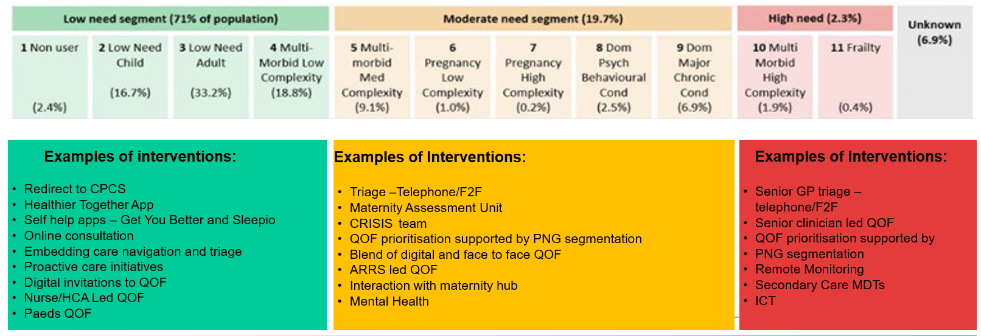
Improved Primary Care datasets are helping BOB to understand population health needs and plan for them
Model of Care
Estates
Workforce
Processes
Technology
Information
Governance
Understanding Population Health Needs
Service Planning
The Shared Care Agreement is providing a much more granular picture of population health needs at place, neighbourhood and practice level
However, in order to gain greater insight, BOB will need to expand input both geographically (by incorporating Oxfordshire) and technically (by incorporating more service providers e.g. Community Services). It will also require expertise and capability to interpret the data, to design interventions and to implement them.
A good understanding of demand and capacity is pivotal to longer term planning of services, for finance, estates, and workforce
Demand data: BOB has acknowledged variation in the quality of demand data for primary care and introduced use of a consistent demand and capacity tool to mitigate this.
Workforce data: Practices are not required to provide their primary care workforce data to the ICB. While there is good quality data on the ARRS roles, there is a lack of national reporting via National Workforce Reporting Service (NWRS) and into NHS Digital centrally-held good quality data for the rest of general practice, which limits the ability to undertake strategic workforce planning in an integrated way across the system.
Service planning: Some practices are now using population health data to help plan services – both for the long term but even just for winter surge planning (see below).
PNG Segmentation information pack V2 – October 2023

Slide 72
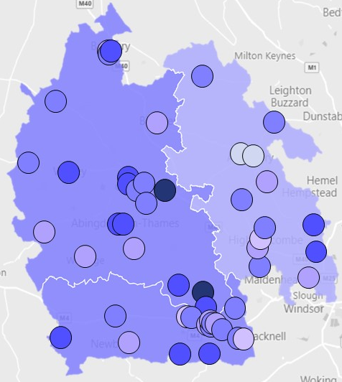
Patient satisfaction varies from 44% to 94% according to national surveys
Model of Care
Estates
Workforce
Processes
Technology
Information
Governance
On average across BOB, 73% had a very or fairly good overall experience; Oxfordshire’s patient satisfaction scores the highest at 77%, Berkshire West is 72% and Buckinghamshire is 66%.
Percentage of patients saying their overall experience of their GP practice was ‘good’
PCN | 2022* Result | 2023 Result*
Central Maple | 55% | 44%
Aylesbury Central | Not available | 48%
Modality Wokingham | Not available | 53%
Cygnet | 60% | 55%
Tilehurst | 76% | 55%
Dashwood | 64% | 60%
White Horse Botley | 60% | 61%
Westongrove | 74% | 61%
Wantage | 70% | 63%
Bicester | 73% | 64%
Reading Holybrook | Not available | 65%
Wokingham North | 70% | 65%
South Bucks | 65% | 65%
Banbury Cross | 65% | 67%
Didcot | 72% | 67%
Kennet | 76% | 68%
New Reading | Not available | 68%
The Swan Network | 74% | 70%
North Bucks | 75% | 70%
Phoenix | 74% | 71%
Woosehill And Crowthorne | Not available | 71%
A34 West Berkshire | 67% | 73%
Mid Chiltern | 76% | 74%
Reading West | 65% | 74%
Reading Central | 66% | 74%
Arc Bucks | 68% | 75%
Reading University | 80% | 75%
PCN | 2022 Result* | 2023 Result*
Phoenix Health | 83% | 75%
South East Oxford Health Alliance (Seoxha) | 79% | 76%
Rural West Oxfordshire | 80% | 76%
City - Ox3+ | 81% | 77%
Banbury Alliance | 79% | 78%
Earley + | 70% | 79%
City - East Oxford | 84% | 79%
North Oxfordshire Rural Alliance | 80% | 79%
Abingdon Central | 78% | 80%
West Reading Villages | 84% | 81%
Kidlington, Islip, Woodstock & Yarnton (Kiwy) | 79% | 81%
Oxford Central | 83% | 81%
Abingdon And District | 85% | 82%
Caversham | 88% | 82%
Healthier Oxford City Network | 85% | 82%
Wallingford & Surrounds | 89% | 83%
Eynsham & Witney | 80% | 83%
The Chalfonts | 80% | 83%
Chesham & Little Chalfont | 83% | 84%
Wokingham South | 86% | 84%
West Berkshire Rural | 85% | 86%
Henley Sonnet | 87% | 92%
Thame | 87% | 94%
2023 and 2022 National GP survey results

Slide 73
7. Governance

Slide 74
Summary of findings and opportunities on Governance
Model of Care
Estates
Workforce
Processes
Technology
Information
Governance
Governance describes the system by which entities are directed and controlled. It is concerned with structure and processes for decision making, accountability, control and behaviour at the top of an entity. Governance influences how an organisation’s objectives are set and achieved, how risk is monitored and addressed and how performance is optimised.
Governance of Primary Care can be thought of across four domains: Corporate Governance Clinical Governance Financial Governance Information Governance.
BOB has a complex health and care landscape and most primary care collaboration happens at Place level.
The composition of ICB Board meets the statutory requirements by including a Primary medical services partner member.
Primary Care has strong governance in place to support place-based working and collaboration across the system is maturing.
There is scope for greater integration of planning and commissioning functions across GP, POD and Community Care.

Slide 75














BOB has a complex health and care landscape with most primary care collaboration happening at Place level
Model of Care
Estates
Workforce
Processes
Technology
Information
Governance
Unitary / upper tier councils
Population of nearly
2 million
156 GP practices
Over 250 care homes
5 Healthwatch
More than 800 schools
5 universities
5 unitary / upper tier local authorities
5 District Councils
8,000 registered social enterprise organisations
Approx 5,000 informal social enterprise organisations
Approx.
68,000 staff
in health and care
2 Community and mental health trusts
Primary Care Networks
3 Acute / integrated
hospital trusts
51

Slide 76
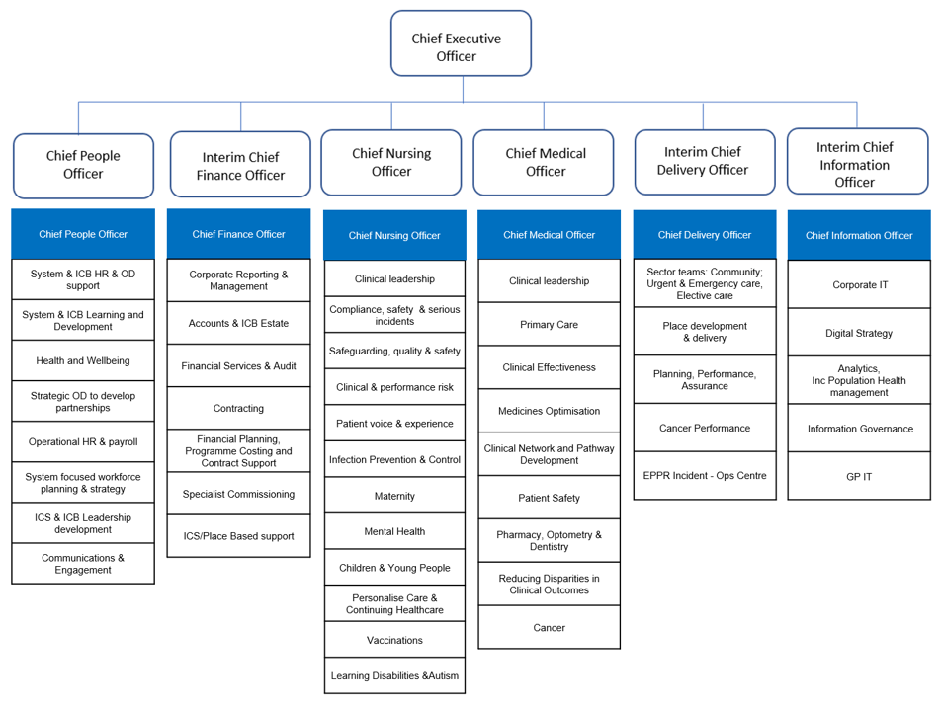
The composition of ICB Board meets the statutory requirements by including a Primary Medical Service partner member
Model of Care
Estates
Workforce
Processes
Technology
Information
Governance
Corporate Governance
There is strong representation of General Practice at a Board Level in BOB
The ICB Operating Framework is currently under review by external consultants in BOB. Our partner member represents Primary Medical Services alongside Local Authorities, Acute trusts and Mental Health colleagues. Primary Care sits in the Medical Directorate with an ICB Director of Primary Care responsible for both General Practice and POD services. There is also a Partner Member of the Board representing Primary Medical Services alongside Local Authority, Acute Trusts and Mental Health colleagues.
Partner Members:
Trusts
CEO Royal Berkshire Foundation Trust
Mental Health
  Medical Director for Berkshire Healthcare Trust
Local Authorities
CEO Buckinghamshire Council
Primary Medical Services
Dr George Gavriel
Wider Executive Team:
ICB Director of Primary Care,
Dr Abid Irfan
BOB ICB Structure

Slide 77
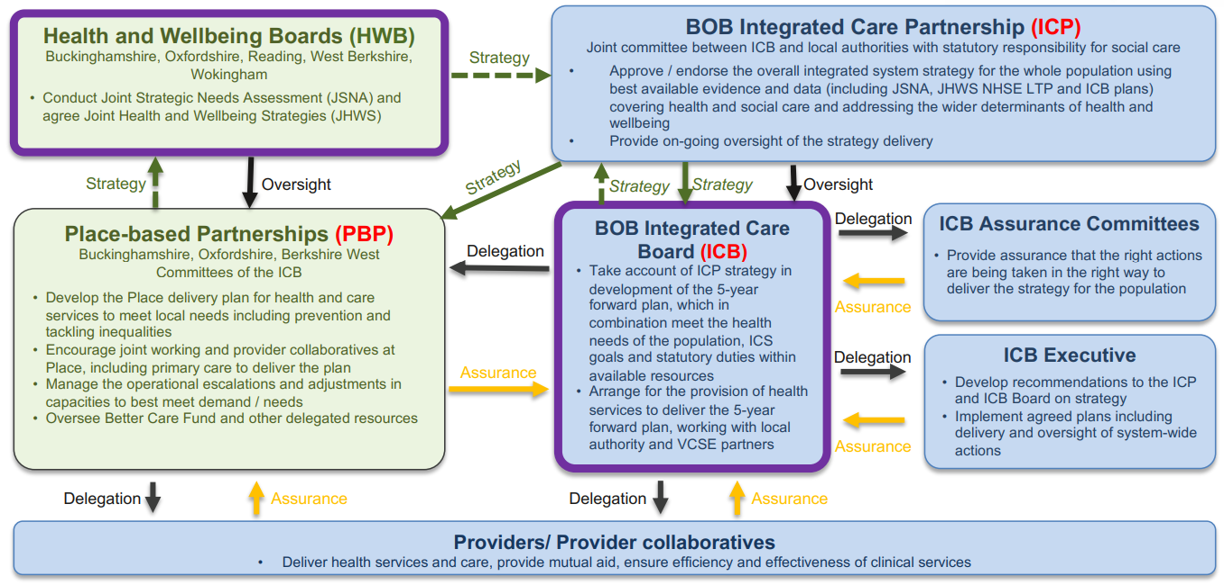
Primary Care has strong governance in place to support Place-based working but coordination across the system is maturing
Model of Care
Estates
Workforce
Processes
Technology
Information
Governance
Corporate Governance
Discussions with senior system leaders as well as in GP
focus groups revealed a consensus that the structures and processes in place for place-based working work well.
In Buckinghamshire, Oxfordshire and West Berkshire, there is both a Director of Place and GP leading the GPLG (GP Leadership Group).
It is at this Place-level that local strategy is developed, some budgets are allocated, and collaborative working between Primary, Secondary and Community services are developed and encouraged – through, for example, Locally Commissioned Services. In Bucks for example, GPs are working in Community Care Home Hubs to support patients recently discharged from hospital.
Working across place-based borders is still maturing however and system leaders cited inefficiencies with plans being made three times rather than just once for the whole system – this applied to both care delivery as well as more management or operational considerations such as procurement of digital systems.
BOB Governance Report

Slide 78
There is scope for greater integration of planning and commissioning functions across GP, POD and Community Care
Model of Care
Estates
Workforce
Processes
Technology
Information
Governance
Financial Governance
There is an opportunity to take a more strategic approach with regard to planning and commissioning of GP, POD and Community Services
As well as integrating the planning function between each of the 3 places, there is an opportunity to integrate planning across Primary and Community Care. At present, there is a nationally mandated component in each of the General Practice, Primary Care Network, Pharmacy, Optometry and Dentistry contract. However, each also has a locally determined component, just over a year ago (1st July 2022), BOB assumed delegated responsibility for POD.
Primary Care Body | Contracts
PCN | Network Directed Enhanced Service (DES) Supplementary Network Service (SNS)
GP Practice | National Contact (GMS, PMS or APMS) Locally Commissioned Services (LCS)
Community Pharmacy | Community Pharmacy Contractual Framework Essential Services Advanced Services Locally Commissioned Services
Optometry | General Ophthalmic Services Contract (GOS)
Dentistry | General Dental Services Contract (GDS) Personal Dental Services Agreement (PDS)
Out of Hours GP | Locally Commissioned in each Place
Community Services | Locally commissioned in each Place
Commissioning of many of these services is currently under review:
Locally Commissioned Services for General Practice; POD commissioning while the system absorbs this new capacity; and one GP Out of Hours contracts is up for procurement
A review of the commissioning cycle in Primary and Community Care may support:
Integrated Working: The importance of joint commissioning in encouraging more integrated services e.g. between District Nursing, the Intermediate Care Teams and General Practice
Long Term Planning: The importance of longer contracts to encourage longer term planning
Financial Sustainability of Providers: The importance of keeping up with rising costs - this was mentioned in relation to both Enhanced Services and Community Care, as well as pharmacy, optometry and dentistry contracts. Community Care contracts haven’t been reviewed for over a decade and this is making it uneconomical to provide certain services
The ambition to move care closer to home: The importance of balancing Primary and Community Care spend with spending on the Acute Trusts
Commissioning for outcomes: Many of the current contracts reward activity rather than outcome.

Slide 79
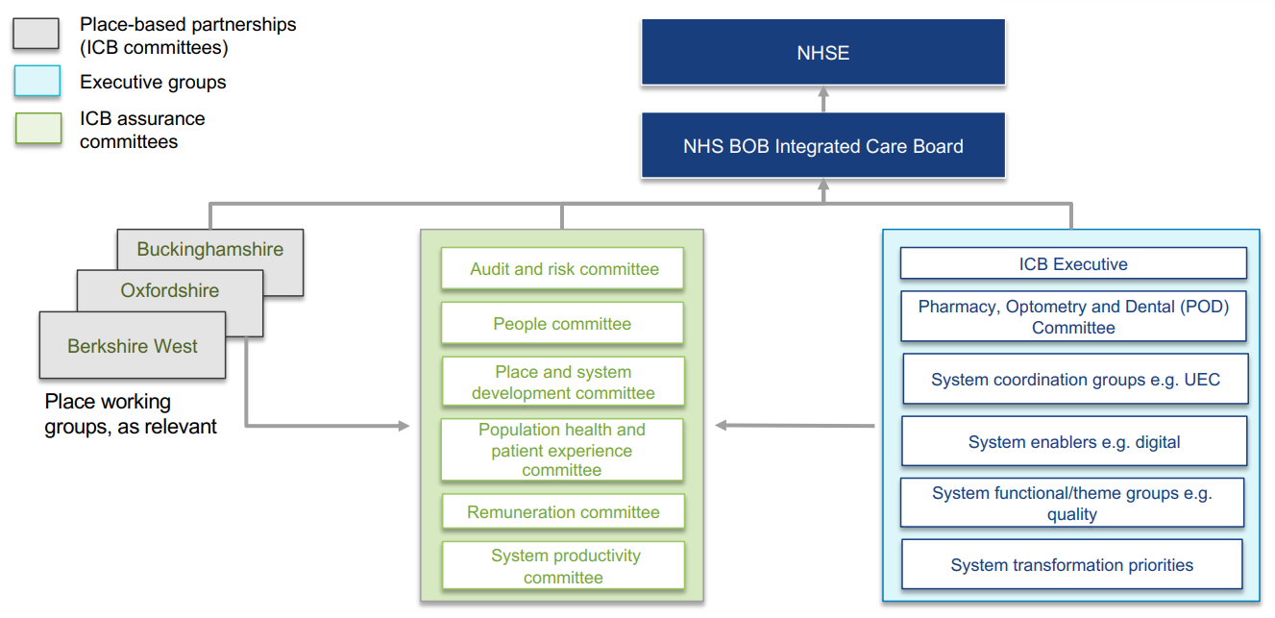
There are structures and processes in place to monitor quality in Primary Care
Model of Care
Estates
Workforce
Processes
Technology
Information
Governance
Clinical Governance
A full review of clinical governance of Primary Care is outside the scope of this report though some observations are noted below:
There are structures and processes in place to provide oversight and assurance to the board on Clinical Governance
Primary care reports through to the ICB Board and appropriate committees like any other commissioned service. This includes:
BOB’s Population Health and Patient Experience Committee, which provides oversight and assurance to the board on service quality and performance, and;
the Audit and Risk Committee, which provide assurance to the board on governance, risk management and internal control processes.
The Primary Care & Quality Team monitor quality and performance through a Primary Care dashboard and present a status report to the Board regularly. The dashboard is mainly process focused (QOF, A+E admission rates etc) and there is an opportunity to move towards more outcome-focused monitoring.
Integrated Clinical Pathways will be critical to greater at-scale, coordinated working
Discussions with clinicians across BOB indicated a need for greater standardisation in both clinical and operational processes as services begin to work more at scale and in cooperation with each other. This might include a standardised approach to triage and navigation for practices working at scale for example, or to clinical pathways for patients with medical and/or social complexity where multiple agencies input into care plans and delivery (including Secondary Care).
Clinical governance will need to evolve as service provision changes
As the model of care develops, it will be essential to ensure all changes are safe and effective. Parallel investment in audit and Quality Improvement capability could help to ensure this, as too could investment in education and training for staff in these activities and greater incorporation of patient feedback.
BOB Governance Report

Slide 80
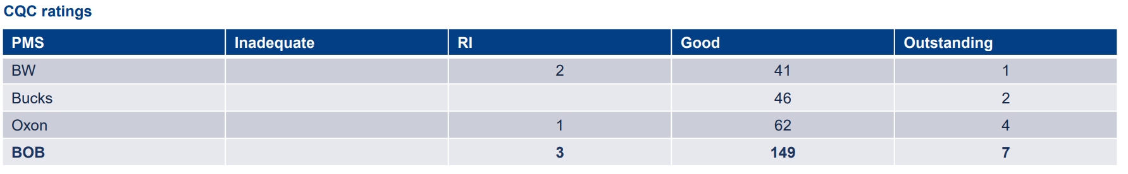
We have developed a local tool called the Primary Care Quality Dashboard which brings together a range of quality indicators
Model of Care
Estates
Workforce
Processes
Technology
Information
Governance
BOB’s Primary Care Quality Dashboard shows above average performance for General Practice. A POD Dashboard is in development
Indicator areas include:
Quality Outcomes Framework (QOF) achievement
Service utilisation – monitoring non-elective admission rates and attendance at A&E and other urgent care services.
Immunisations, vaccinations and screening uptake rates
CQC ratings
Patient Satisfaction (through Friends and Family Test and National Patient Survey Outcomes)
BOB scores above average for QOF
Annually a ‘deep dive’ into QOF achievement is conducted, comparing performance and prevalence between GP Practices and also comparing variance in performance between reporting years.
BOB scores just above average for QOF achievement at 92.5%.
Ambulance, A+E and Non Elective Admissions rates are high
An average of 200 patients per 1000 attended A&E in the last year.
Non Elective Admissions for Ambulatory Sensitive Conditions was also high.
The Dashboard compares GP Practices against national, BOB, Place and PCN averages and rag rates performance. It also compares individual GP Practice performance across comparable time periods so that trends overtime can be made. An overall rag rating of practice is underdevelopment.
Outcomes of CQC inspection, the independent regulator of health services ensuring services, provide people with safe, effective, compassionate and high-quality care, are used to identify GP Practices which may require support/guidance to improve service delivery. This includes access to GP services under their responsive single inspection visits.
Most GP practices are rated either good or outstanding
A small number of GP practices are rated Requires Improvement.
BOB ICB M1 2023/24 Performance Report

Slide 81
Summary and Conclusions

Slide 82
Snapshot of findings for each of BOB’s Places (in comparison to each other)
Buckinghamshire
Higher levels of social isolation (p11)
Higher proportion of over 75 year olds (p11)
Higher proportion of 16-17 years not in education, employment, or training (p11)
Highest proportion of GP appointments seen on the same day (p14)
Lowest satisfaction with GP access and overall GP satisfaction (p16)
111 calls per 100,000 population similar to Berkshire West, higher than Oxfordshire (p18)
Approx. 23 patients per m² of primary care estate (p46)
Oxfordshire
Deprived areas cluster in Oxford and Banbury (p11)
Higher proportion of over 75 year olds (p11)
Children in receipt of free school meals have lower levels of good development (p11)
Highest proportion of GP patients seen within 14 days (p13)
Highest satisfaction with GP access and overall GP satisfaction (p16)
Lowest number of 111 calls per 100,000 population, but highest proportion of these that are out of hours calls (p18, 19)
Highest number of GPs and nurses per 10,000 population (p54)
Approx. 18 patients per m² of primary care estate (p45)
Berkshire West
Deprived areas cluster in Reading (p11)
Highest growth expected in over-70s age group (p11)
Reading is the most ethnically diverse area (p11)
Lowest proportion of GP patients seen within 14-days (p13)
111 calls per 100,000 population similar to Buckinghamshire, higher than Oxfordshire (p18,19)
Highest A&E activity (p23)
Lowest number of GPs per 10,000 population (p50)
Lowest proportion of general practice activity carried out by a GP (p54)
Some practices are using a risk stratification and segmentation tool to support triage (p38)

Slide 83

Summary of findings and opportunities on Access
Findings
Opportunities
There are a range of primary care access models in place across BOB, responding to different population needs and workforce assets.
BOB has slightly lower numbers of GP appointments per weighted population than the national average - but is nevertheless delivering a slightly greater proportion of appointments within 14 days than the national average.
Total GP activity has risen slightly over 5 years, driven by increased telephone consultations.
Patient satisfaction with access has declined over recent years and varies across Places.
Buckinghamshire has the lowest rate of GP appointments, the highest proportion of same day access, and the lowest patient satisfaction with access.
111 calls peaked in 2021 in all Places; in 2022 Oxfordshire had the lowest rate of calls, but the highest proportion of out of hours calls.
ED activity has risen slightly since 2019 with higher acuity activity rising fastest; Urgent Care activity has dropped slightly.
Berkshire West has a higher rate of A&E activity then other Places.
Available data suggests BOB has a lower percentage of dental patients seen by an NHS dentist than the national average
Data was unavailable but local reports suggests there is scope to make even more use of capacity in community pharmacy and optometry.
Move towards standardised at-scale triage and navigation across PCNs and ideally Places – building on the models that are working now.
Ensure triage functions can direct patients to a range of first contacts including community pharmacy, optometry, dentistry and urgent care and build out direct access pathways to community services e.g. MSK.
Expand use of Population Health Management (PHM) tools that conduct prior risk stratification of patients.
Monitor the trials of Same Day Access Hubs in Berkshire West and share learning of role of physically co-located multi-disciplinary teams versus digital service.
Monitor and encourage local demand and capacity modelling – seek insights from other systems successfully deploying this.
Better define the purpose of UTCs/ UCCs and standardise how they are used in access pathways.
Review community pharmacy closures and ensure plans for new roles such as independent prescribing are embedded in access developments at PCN and Place levels.

Slide 84
Summary of findings and opportunities on Continuity
Findings
Opportunities
There are many examples in BOB of professionals and teams from across the system working well together to provide personalised care to people with long term conditions, medical complexity and/or social complexity.
There are multiple locally-designed commissioning approaches for General Practice, Community Pharmacy, Community Health Services, and broader partners, including the development of Integrated Delivery Networks.
These are designed to provide personalised integrated care and support for people with Long Term Conditions. BOB performs well on QOF and LTC management in General Practice is generally good but there is local variation.
At system level, the approach is somewhat fragmented, with variation in coverage, and a lack of ability to demonstrate the strategic value of these interventions, and underutilisation of the full range of support available for people including from the voluntary and community sector.
Surveys suggest patients would value still more support with LTCs, and staff in General Practice would like to spend more time on prevention and chronic disease management.
Reviews of Locally Commissioned Services (LCS) and the delegation of commissioning for Pharmacy, Optometry and Dentistry provides an opportunity to take a more strategic commissioning approach that ensures activity is well-targeted to tackle inequalities and value can be demonstrated.
                Develop a blueprint for Integrated Neighbourhood Teams that PCNs can use alongside demand and capacity planning, to further develop MDT working in a consistent manner, coordinated through Place and ICB leadership.
                The blueprint should ensure that Integrated Neighbourhood Teams become the organising principle that brings together current fragmented support offers – using a PHM data-driven approach to set areas of focus (based on tackling inequalities and improving outcomes), with a shared physical and digital space for multi-disciplinary teams formed of (for example) general practice staff (inc ARRS), district nurses, community pharmacists, voluntary sector workers, carers etc.
                Develop agreed Clinical Pathways for common Long Term conditions that span Primary (including pharmacy, optometry and dentistry), Secondary and Community Care to improve coordination of care across all providers.
                Continue to implement shared records to enable more integrated working across Primary, Secondary and Community Care.
                Work to enhance the primary secondary care interface to enable a more joined up approach to care for patients.
                Bring together the various reviews of commissioned support for LTCs to maximise benefits of an integrated commissioning approach across primary care pillars, community care and acute.

Slide 85
Summary of findings and opportunities on Prevention
Findings
Opportunities
BOB is in a good position in terms of already having some excellent Population Health Management infrastructure in place in the form of the Connected Care / Graphnet risk stratification and segmentation tools.
There is work to do to expand this infrastructure across BOB, and then to support PCNs and wider partners to put the tools to use to gain insights into their local communities, design interventions in response, track impact, and stop or scale activity.
At Place level, prevention efforts are being targeted at narrowing inequalities by focusing on Core20Plus5 and partnering with the voluntary and community sector to support outreach efforts and the delivery of interventions.
Social prescribing is seen as valuable in providing a more holistic and less-medicalised approach where appropriate, and could be spread and scaled.
BOB commissions a wide range of preventative interventions, including from community pharmacy, optometry and dentistry, but there are further opportunities to maximise the preventative role across all the pillars of primary care.
Whilst there are many examples of innovative partnerships between GPs, wider primary care, community services, mental health services and the voluntary sector, the overall approach is seen as opportunistic and fragmented rather than strategic and data-driven.
Spread the existing PHM tools, and support PCNs to use them to put interventions into practice – may require operational support at a local level to design, implement and evaluate local initiatives.
Continue to expand the data sharing agreement to Oxfordshire to ensure BOB is able to devise targeted prevention initiatives at system, place and neighbourhood level.
Strengthen the multi-disciplinary PHM leadership at system level (as well as the technical capabilities and software) – for example, to incorporate PHM into the commissioning cycle so funding reflects needs and incentivises service development in the right areas.

Slide 86
Summary of findings and opportunities on Enablers
Findings
Opportunities
Primary Care estate is becoming less fit for purpose over time, with challenging funding and local planning rules hindering development.
Recruitment, retention and supervision issues are limiting the impact of new roles and multi-disciplinary working.
There is variation between practices in their approach to front, middle and back-office functions and much activity is not patient-facing.
Multiple digital triage platforms and three EPRs are being used with varying effectiveness
Improved Primary Care datasets are helping BOB to understand population health needs and plan for them.
Primary care governance and collaboration is strong at Place level
Consider options to support estate developments e.g. practical co-location options at PCN and Place level.
Consider partnerships to increase workforce capacity, and work at-scale to support delivery of training and supervision to new roles in integrated teams.
Build on the Oxfordshire QI interface project to scale initiatives that reduce back office and admin workload to free staff time for higher-value activities.
Trial greater use of robotic and AI triage, and video consultations for same day care, to enhance access.
Review funding allocations and mechanisms for supporting a shift towards out of hospital services.

Slide 87
End of report
Thank you to all those colleagues from the BOB Integrated Care System who spent time sharing their expertise and insights.

Slide 88
Glossary of terms
Term | Definition
A&E | Accident and Emergency
AI | Artificial Intelligence
ARRS | Additional Roles Reimbursement Scheme
BOB | Buckinghamshire Oxfordshire and Berkshire West
CAS | Clinical Assessment Services
CDS | Community Dental Services
CVD | Cardiovascular disease
CQC | Care Quality Commission
CPCS | Community Pharmacy Consultation Service Scheme
DES | Directed Enhanced Service
EMIS | Education Management Information Systems
EPR | Electronic Patient Records
EPS | Electronic Prescription Service
ED | Emergency Department
F2F | Face-to-face
FTE | Full-time Equivalent
GDS | General Dental Service
GPLG | General Practice Leadership Group
GP | General Practitioner
HWB | Health and Wellbeing Board
ICB | Intergrated Care Board
ICP | Integrated Care Partnership
ICS | Integrated Care System
ICT | Intermediate Care Team
JFP | Joint Forward Plan
Term | Definition
KPI | Key Performance Indicator
LMC | Local Medical Committee
LCS | Locally Commissioned Services
LTC | Long Term Condition
MECS | Minor Eye Condition Service
MDT | Multidisciplinary team
ONS | Office for National Statistics
PBP | Place Based Partnerships
PROMS | Patient Reported Outcome Measures
POD | Pharmacy Optometry Dentistry
PHM | Population Health Management
PQS | Prescribing Quality Scheme
CAS | Primary Care Clinical Assessment Service
PCN | Primary Care Network
QI | Quality Improvement
QOF | Quality and Outcomes Framework
QI | Quality Improvement
SDEC | Same Day Emergency Care
SLA | Service-level agreement
UEC | Urgent and Emergency Care
UCC | Urgent Care Centre
UDA | Unit of Dental Actvity
UTC | Urgent Treatment Centre
VCSE | Voluntary, community or social enterprise

